Slide 1
Parent Information Meeting
Autumn 2023
Year
4

Slide 2
Who’s Who ?
Class 4SD Class 4H
Mr Syme/ Miss Davies Miss Henesey
Mrs Wilkinson Miss Toms
Mrs Kwiatkowska Mrs Unegbu

Slide 3
Curriculum
Our medium term plan, will keep you informed about the subjects your child will be studying each term. It will be posted on the school website.

Slide 4
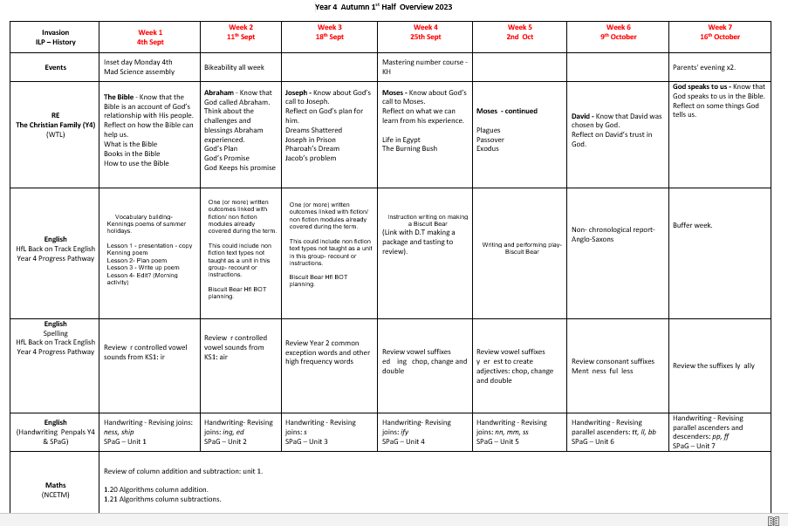
Medium Term Plan

Slide 5
Reading
It is important that your child reads regularly at home and their reading record should be signed each time by an adult.
They can read their own books from home or choose a book from the class library to take home and read.
Children’s reading records will be checked each week. If your child is not reading regularly at home, we will arrange a meeting with you to discuss this further.

Slide 6
Reading at home
Remember to spend as much time talking about the book as reading the book:
What is happening?
What might happen next?
Why did the character act like that?
What is your favourite part and why?
It is your child’s responsibility to take their book home at the end of the day and to change their home reading book when they need to.

Slide 7
Homework

Slide 8
Multiplication tables Check
By the end of Year 4, all children are expected to know their multiplication tables up to 12 x12, with rapid recall.
During the Summer term, all Year 4 children will be taking a National multiplication times tables check.
Please support your child in learning their times tables at home, as this knowledge is a life skill. We will teach times tables at school, but they will lots of practice at home.

Slide 9
School Uniform
School uniform is listed on the school website
Long hair (both boys and girls) must be tied back
No large bows or accessories are allowed
Earrings must be studs / no nail varnish
Only school book bags are allowed
Please label all clothing clearly with your child’s name
Girls must wear socks for PE, not tights.
Appropriate footwear for PE
On PE days children should come to school in their PE kit:
Mr Syme Mon/Thurs Miss Henesey Mon/Thurs
Forest school: Wednesday

Slide 10
Attendance
Year 4 children should arrive in their classroom from 8:40
The class register closes at 8:45am. If your child is late they must enter through the front office.
Children will come out of the year 1-2 slope and be collected from there at the end of the day.
School day, for Year 4, ends at 3:15pm and any children not collected by 3:20pm will be sent to After School Club and you will be charged

Slide 11
Sickness
Please phone the school office by 9:30am if your child is unwell and give the reason for their absence.
If your child has vomited, or has had diarrhoea, they must be 48 hours clear before returning to school.

Slide 12
Social Media
Children of primary school age should NOT be using any social media
There is a legal minimum age of 13+
School takes no responsibility for issues that arise through the use of social media
Mobile phones should not to be brought into school
If you feel that your child needs a mobile phone for their journey to school, please fill out the google form.

Slide 13
Communication
If you have any concerns, please speak initially to your child’s class teacher
Your class teacher will refer you to the leadership team if necessary
Appointments to see your child’s teacher can be arranged through the school office
Teachers are only available after school, (except on Wednesday)
Email contacts:
khenesey@sphoward.herts.sch.uk
tsyme@sphoward.herts.sch.uk
adavies@sphoward.herts.sch.uk

Slide 14
Safeguarding
Please support us in keeping our school a safe place
Parents will only be able to access the school building via the school office at all times

Slide 15
Playground Safety
Children are not allowed to use the Trim Trail before or after school.
No ball games, riding of bikes and scooters on the playground before or after school.

Slide 16
Partnership
We very much look forward to working in partnership with you and your child over the coming year and we thank you for your continued support of our school.

