Slide 1
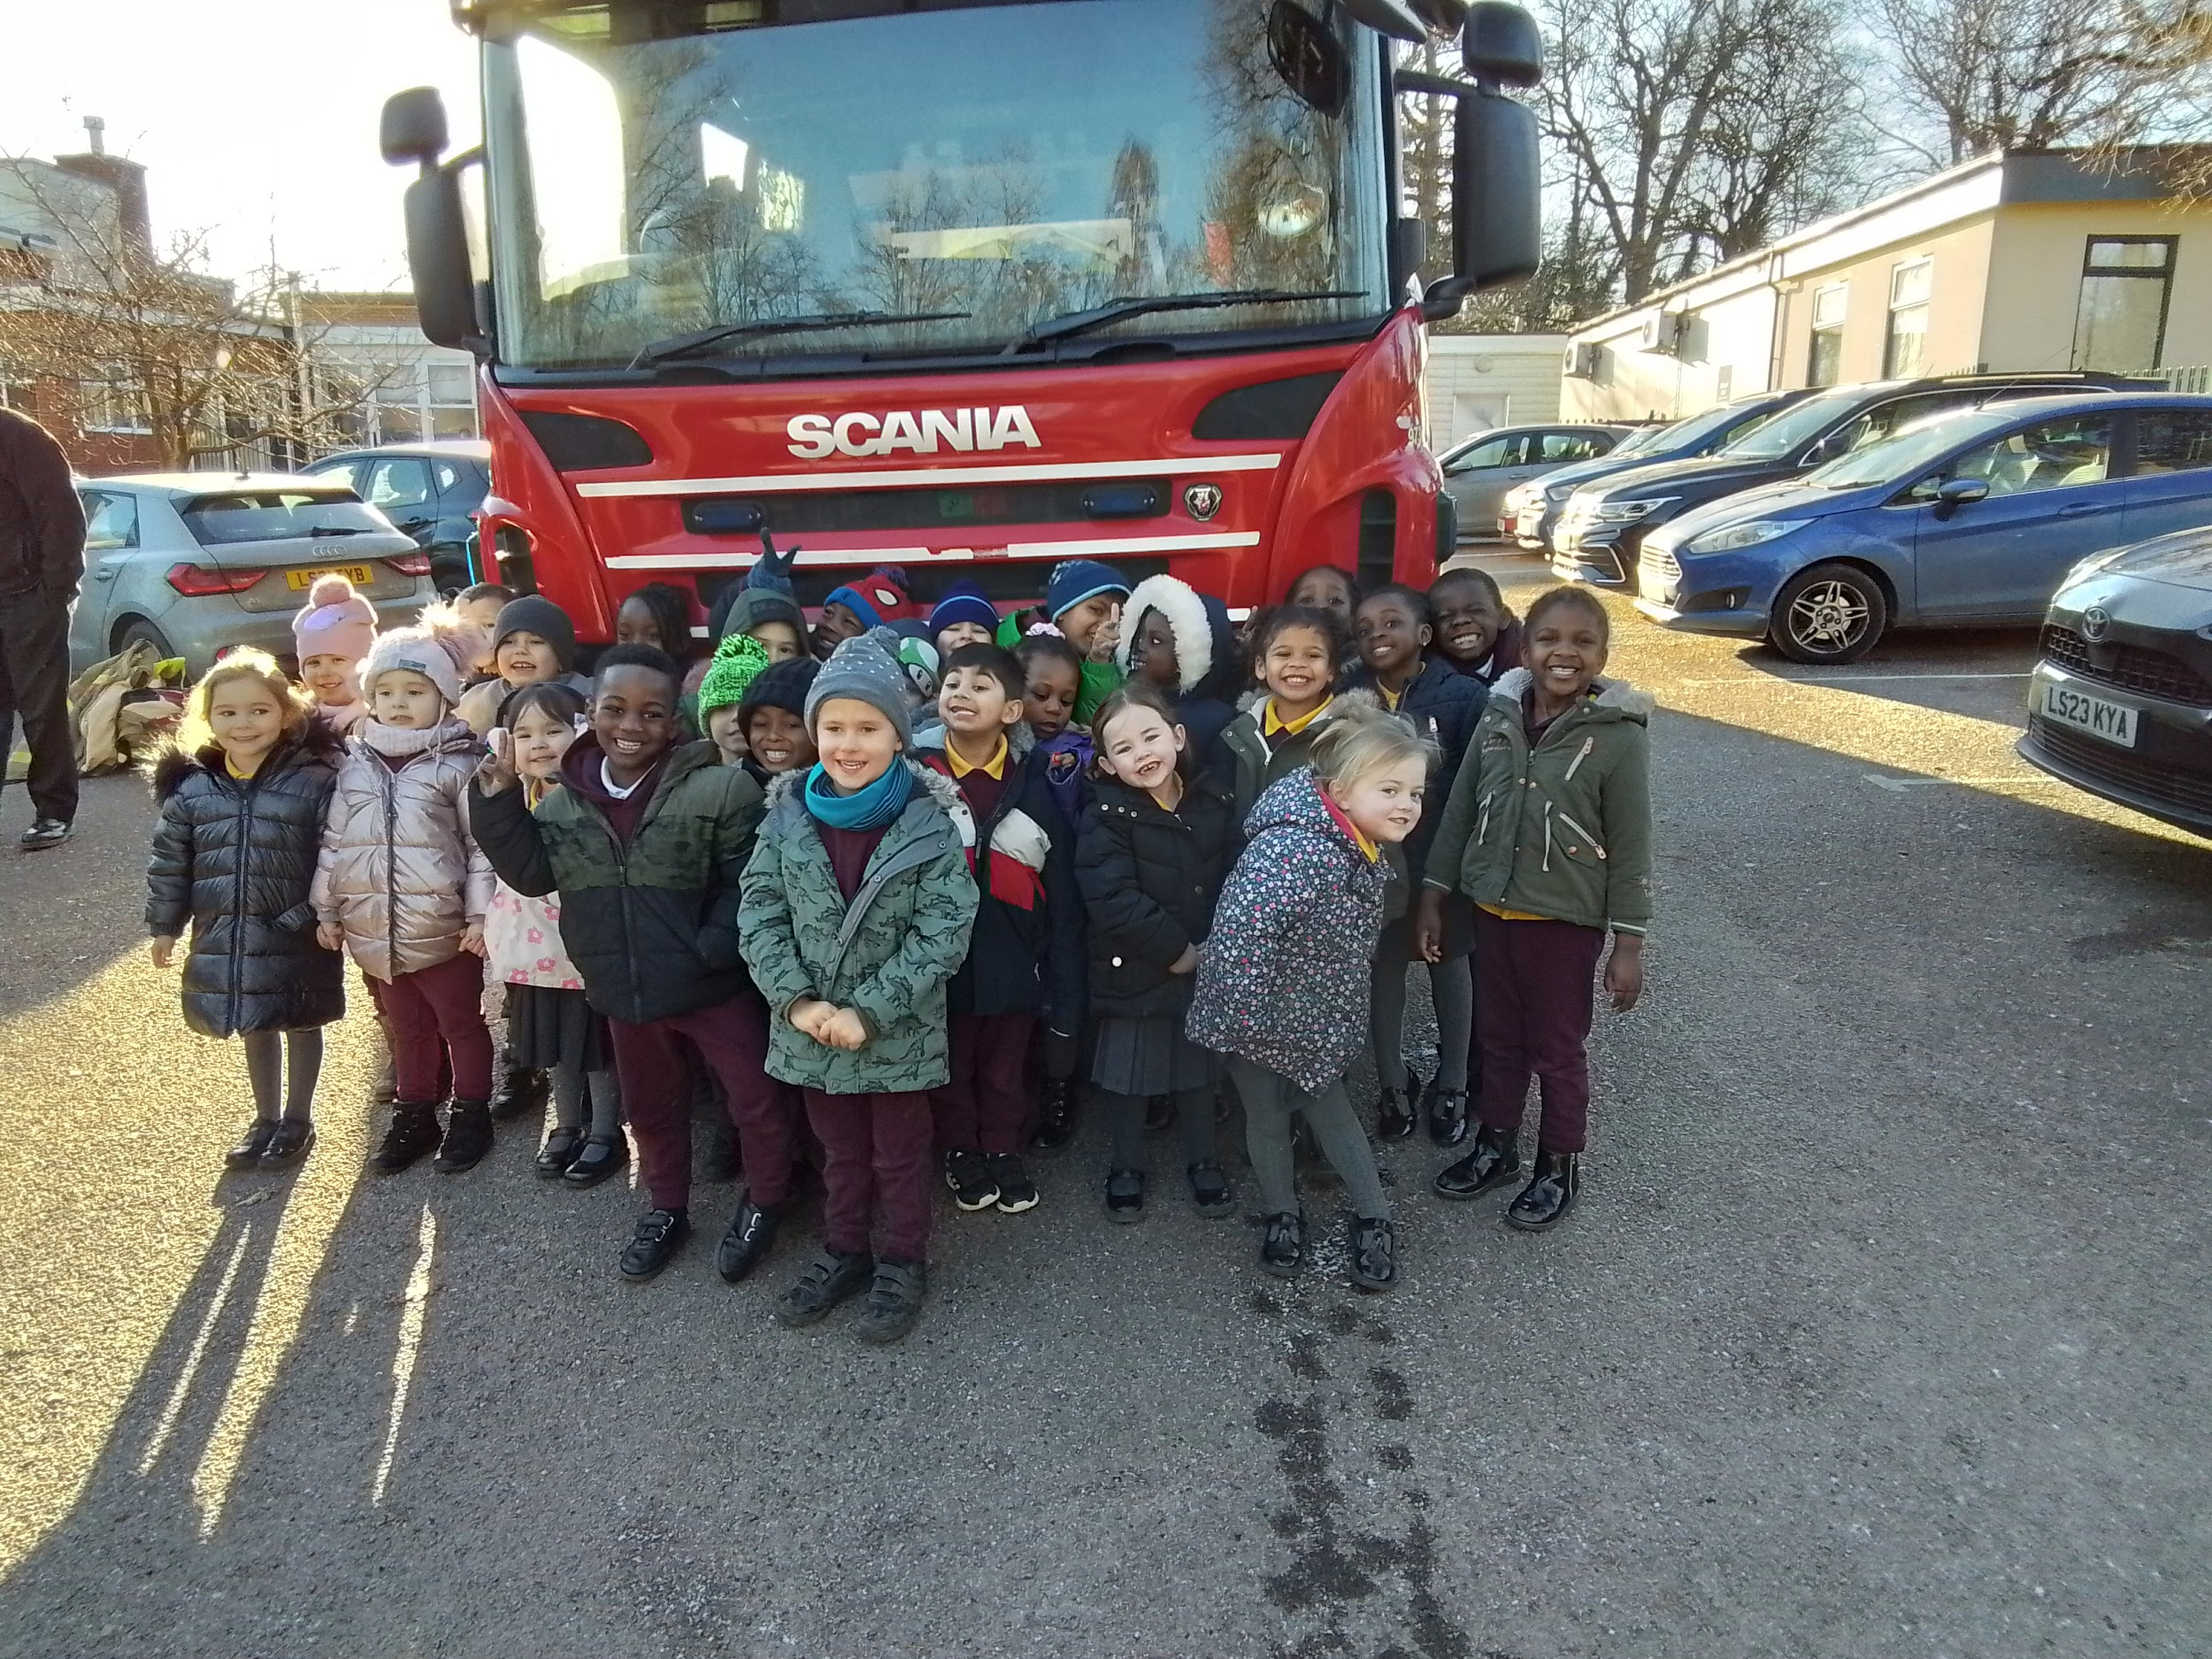
Our Favourite Books

Slide 2
We brought our favourite books into school and told our friends why we like them.
Sunshine Class - 2024

Slide 3
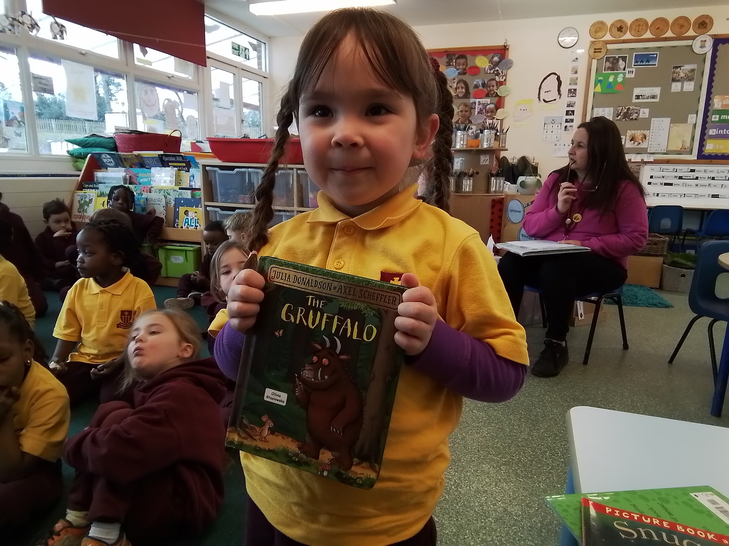
The Gruffalo - I like the mouse.

Slide 4
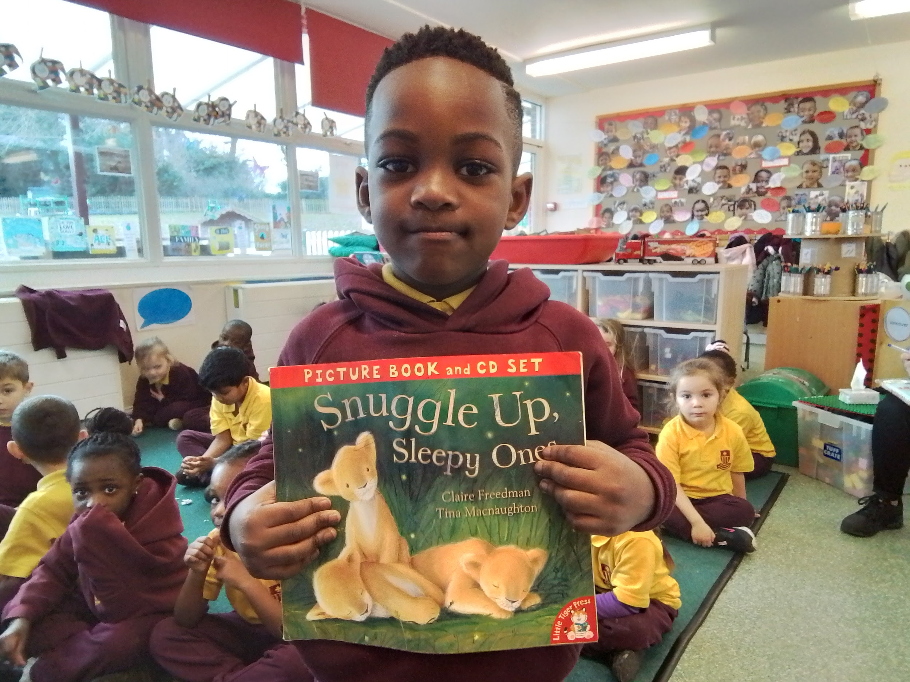
Snuggle Up Sleepy One - It’s got lions and horses.

Slide 5
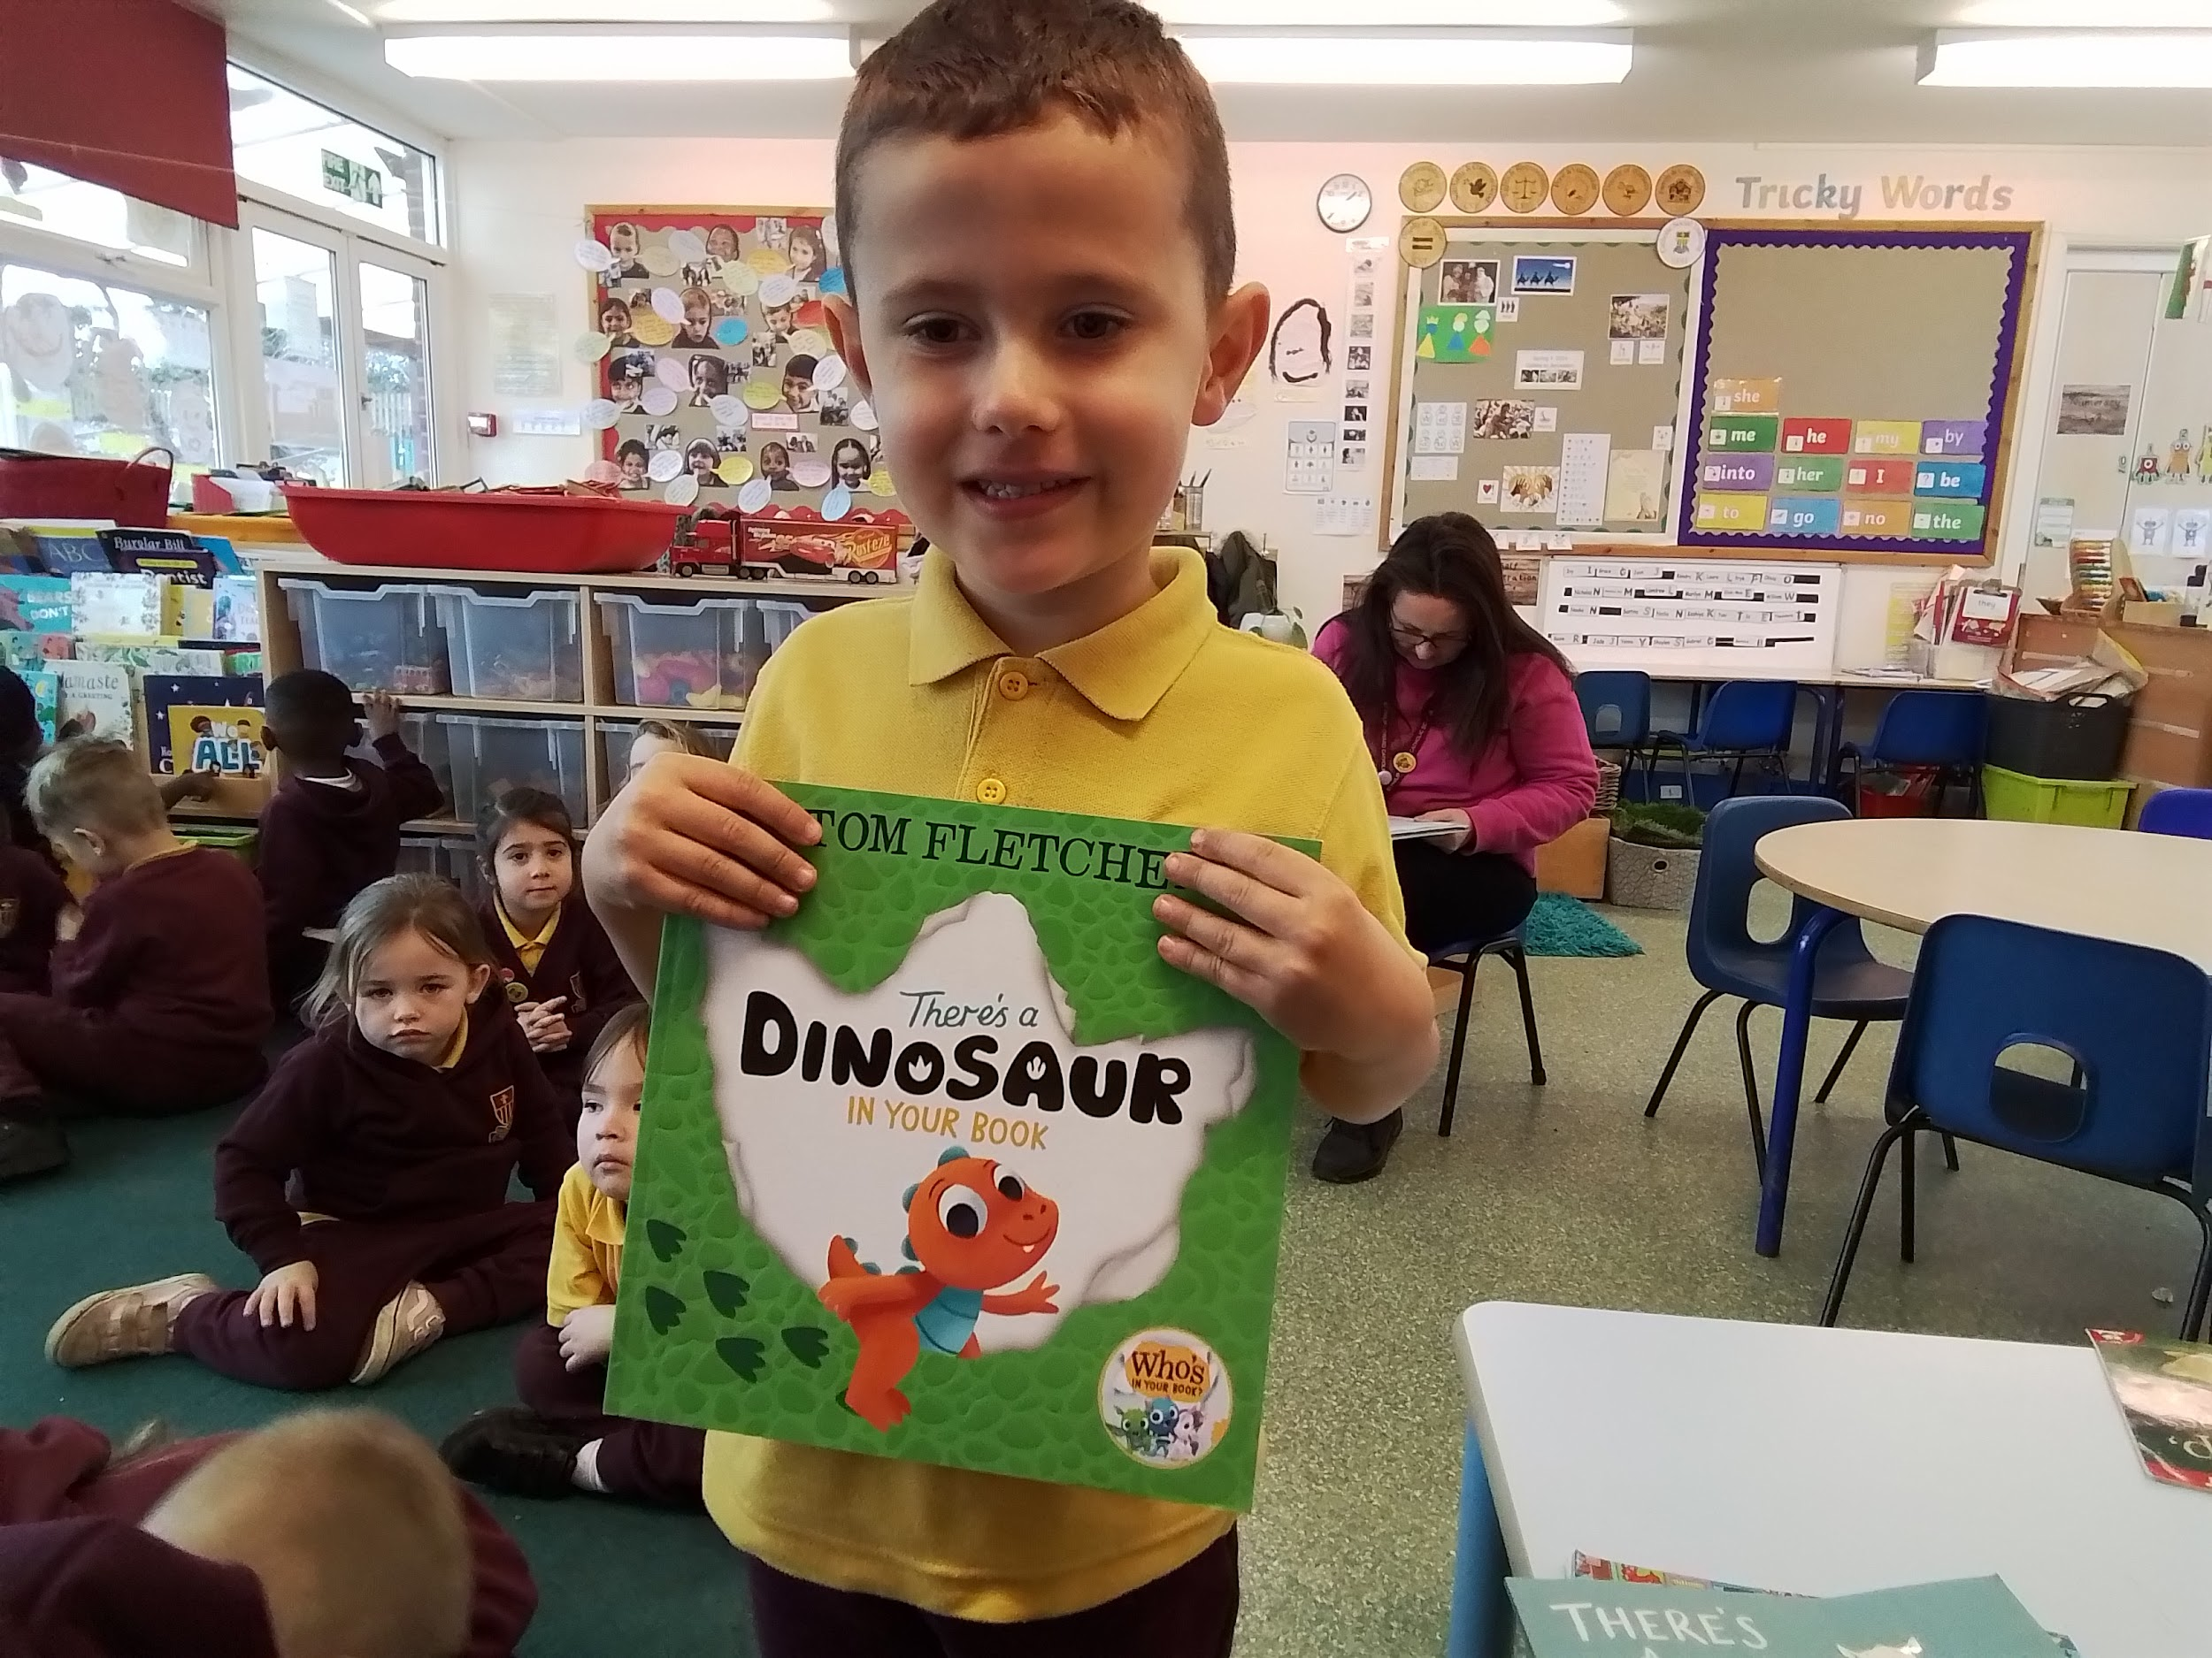
There’s a Dinosaur In Your Book - I like the roar.

Slide 6
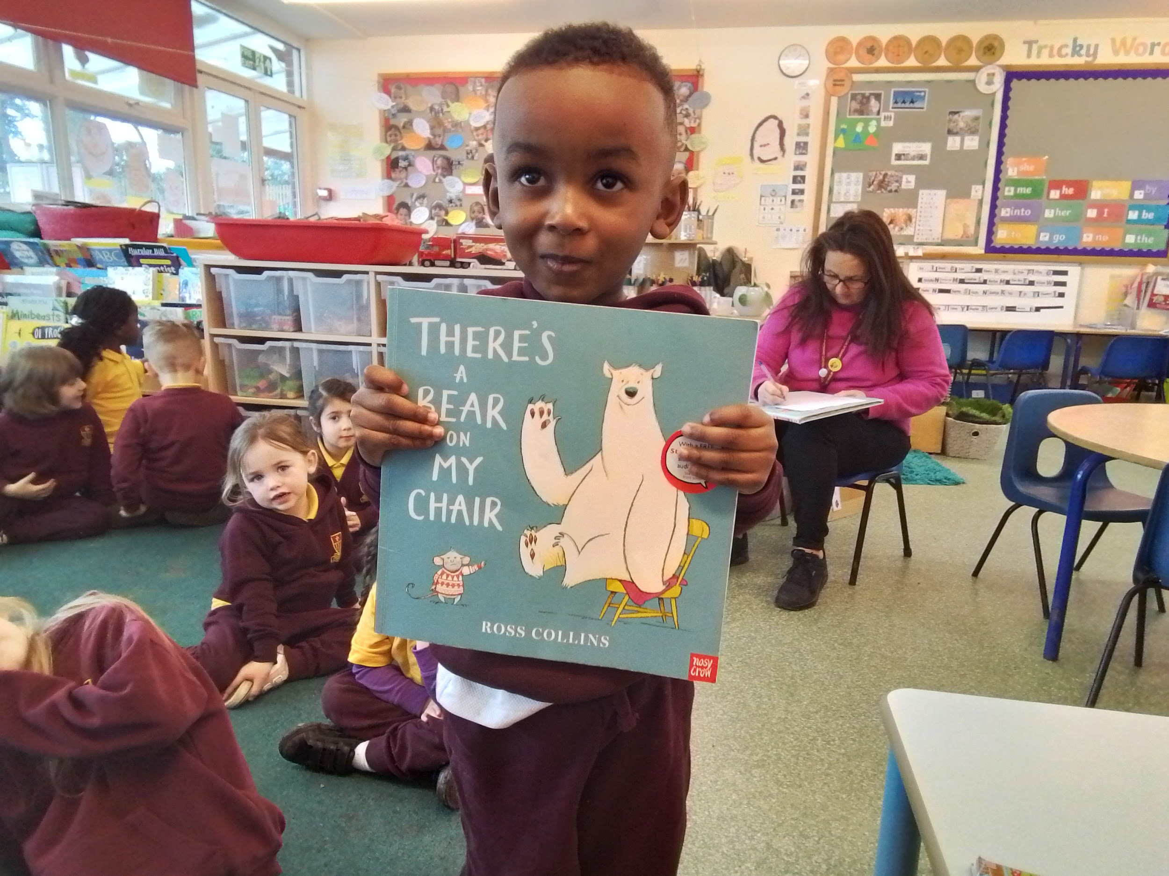
There’s A Bear On My Chair - The bear won’t get off the chair.

Slide 7
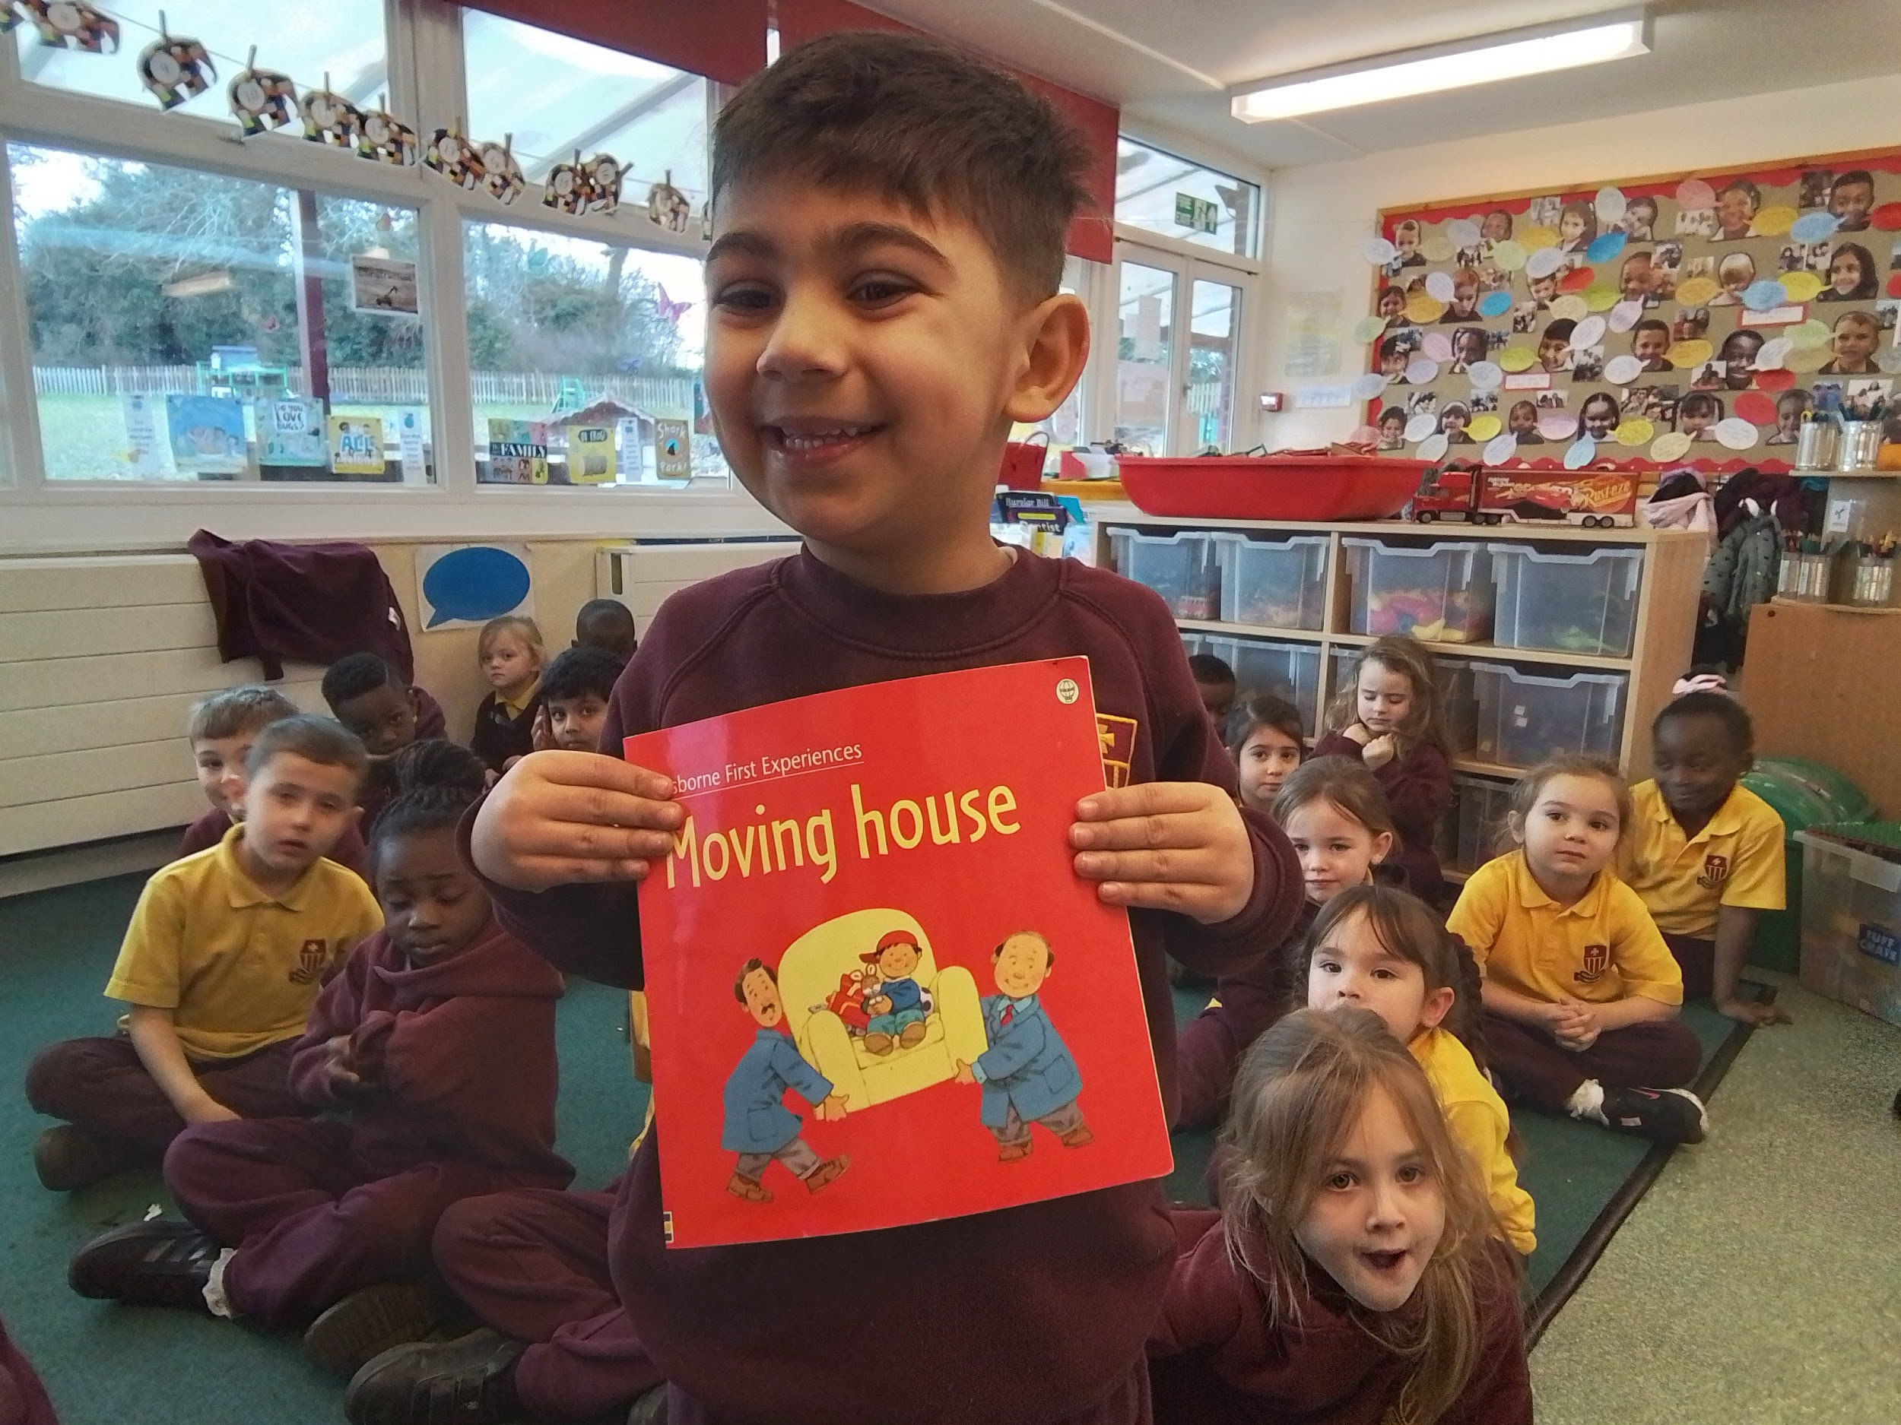
Moving House - I like the moving house. It’s a funny book.

Slide 8
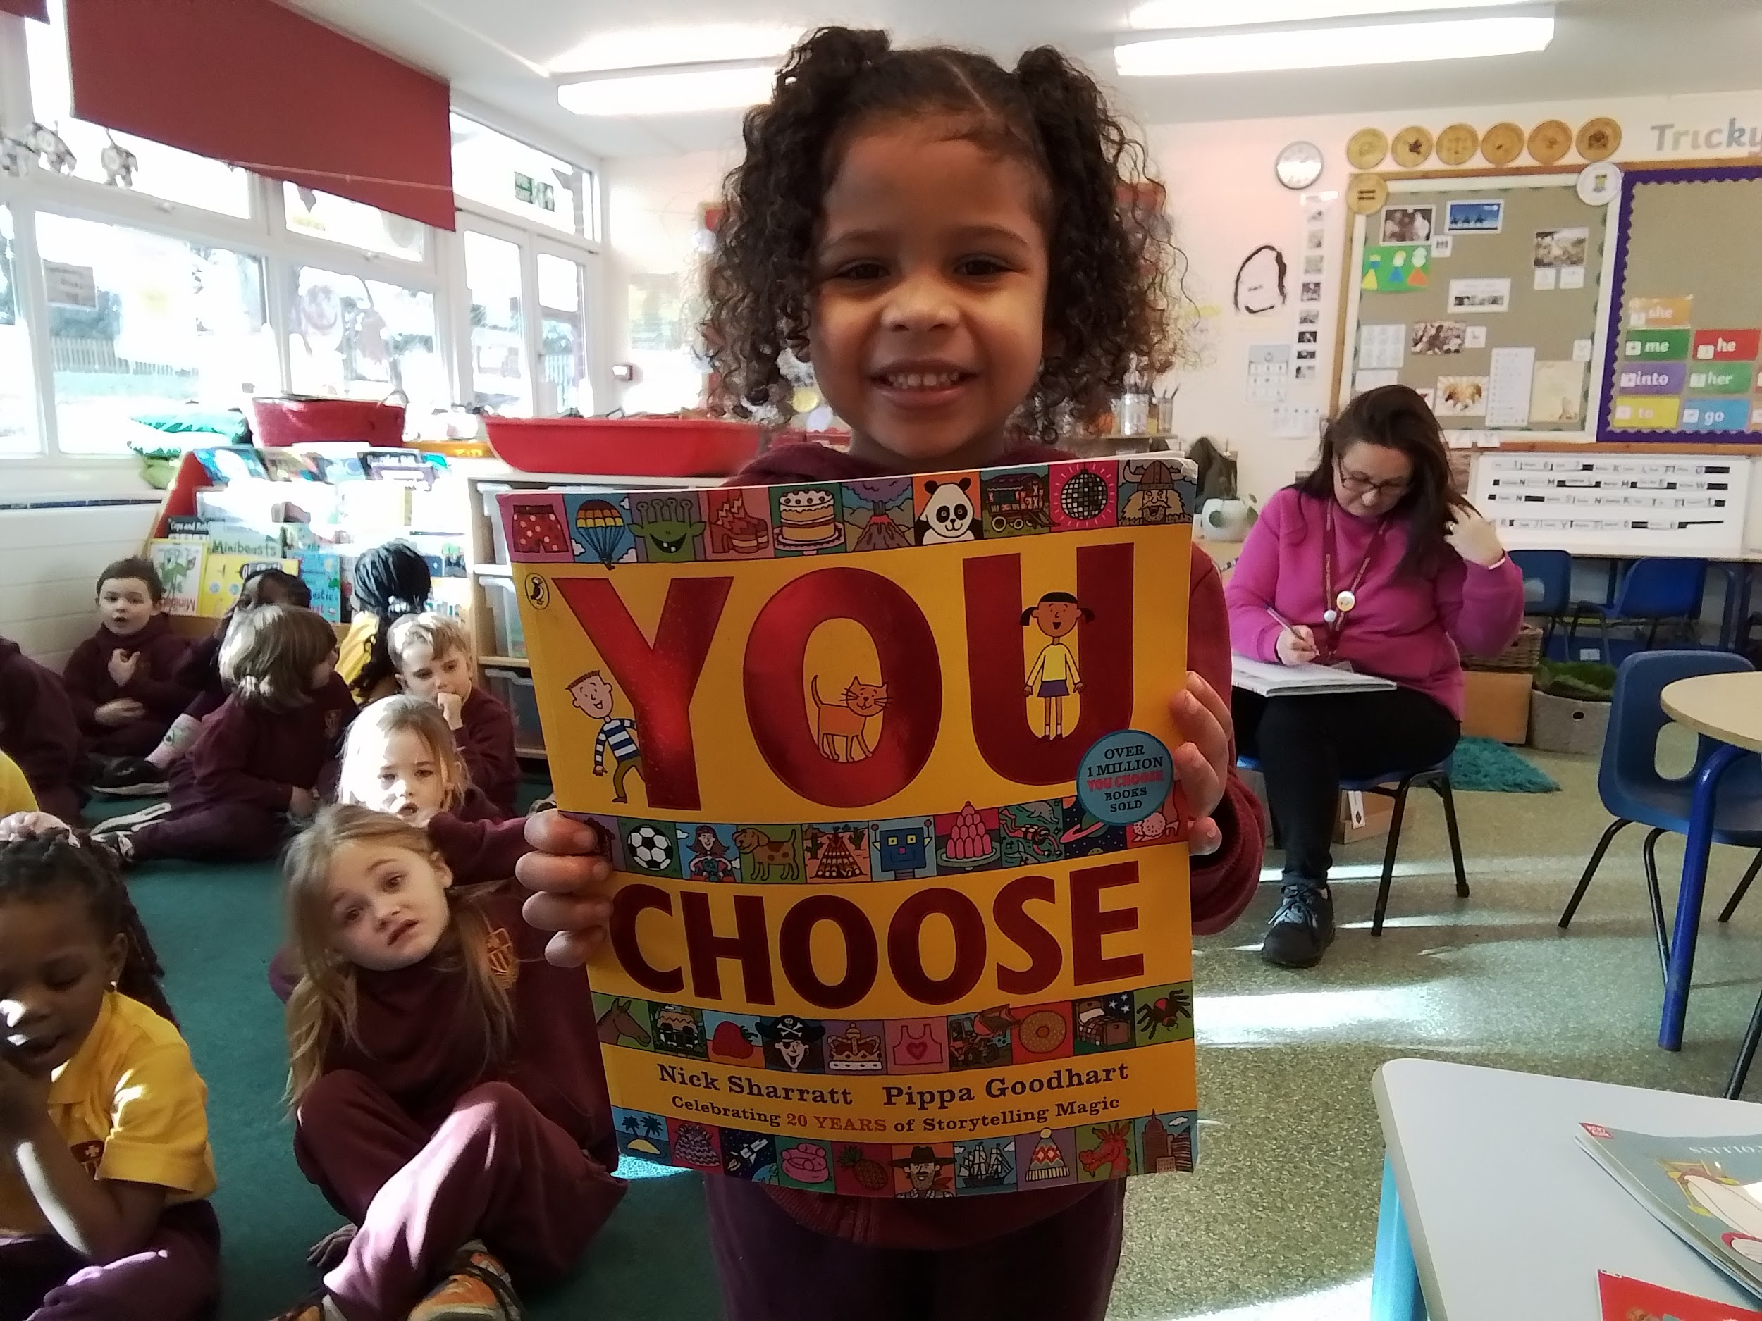
You Choose - There are lots of things you can choose. You choose the story.

Slide 9
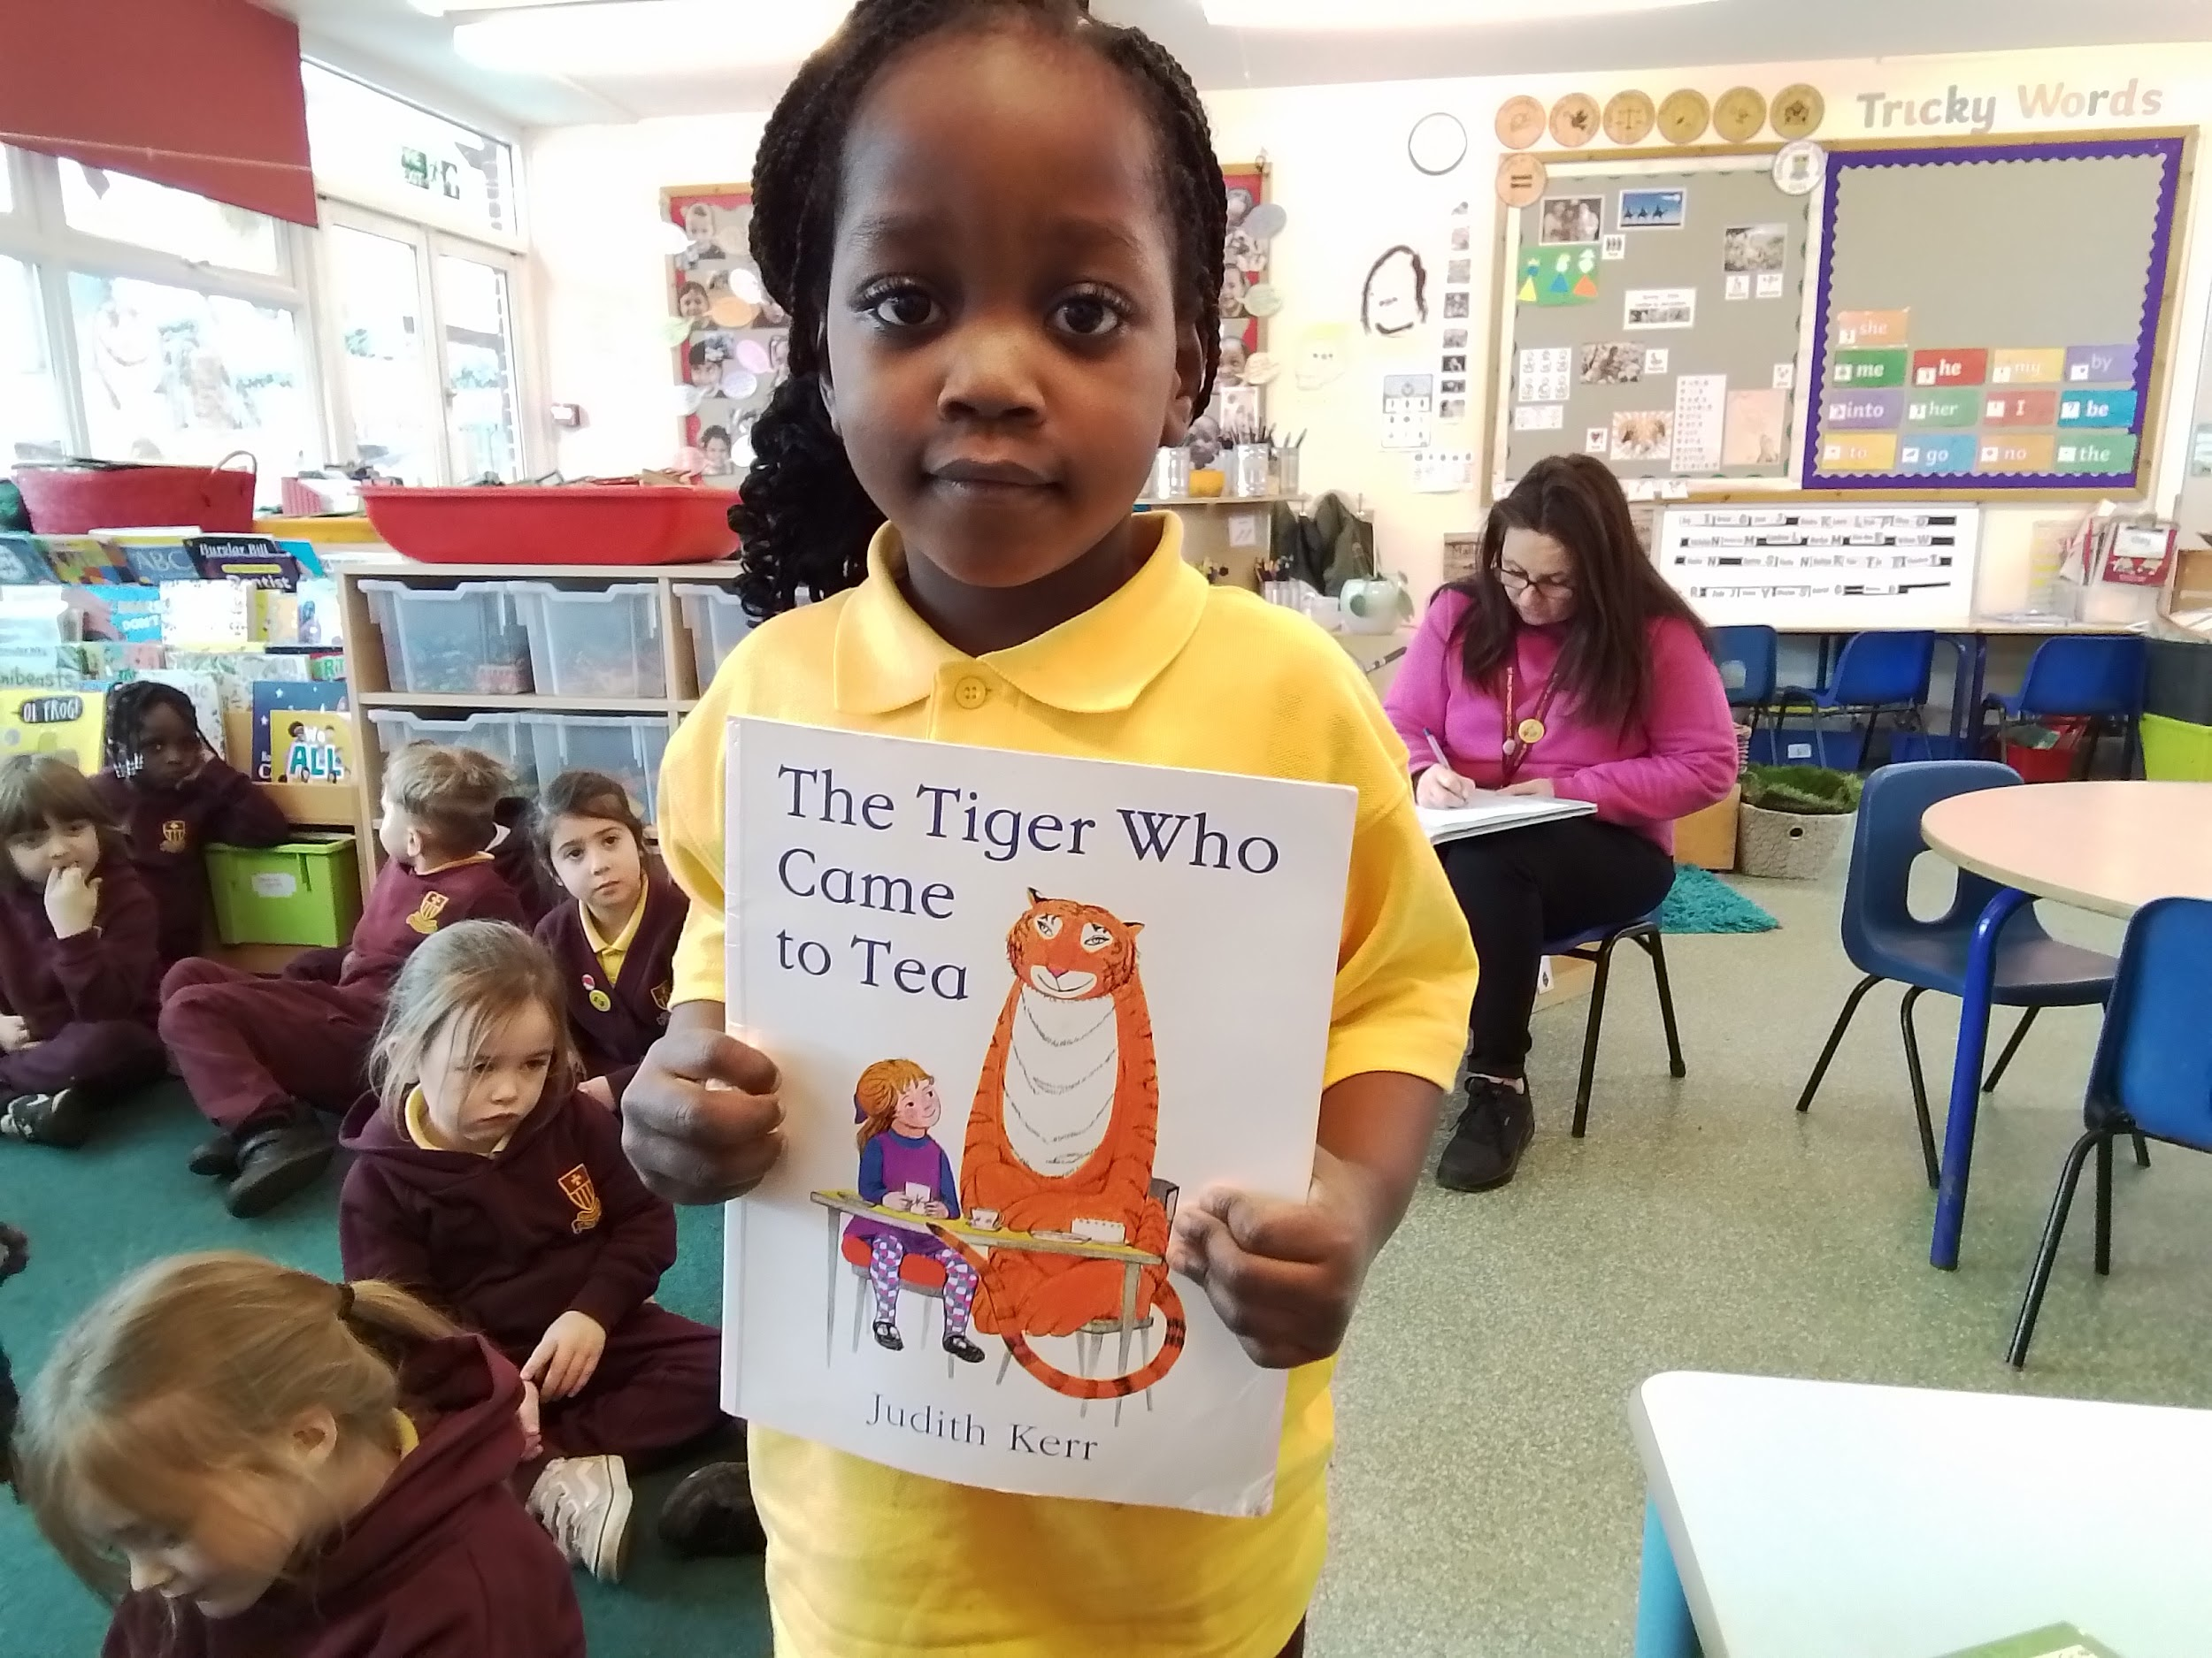
The Tiger Who Came To Tea - I like the tiger, he eats all the food.

Slide 10
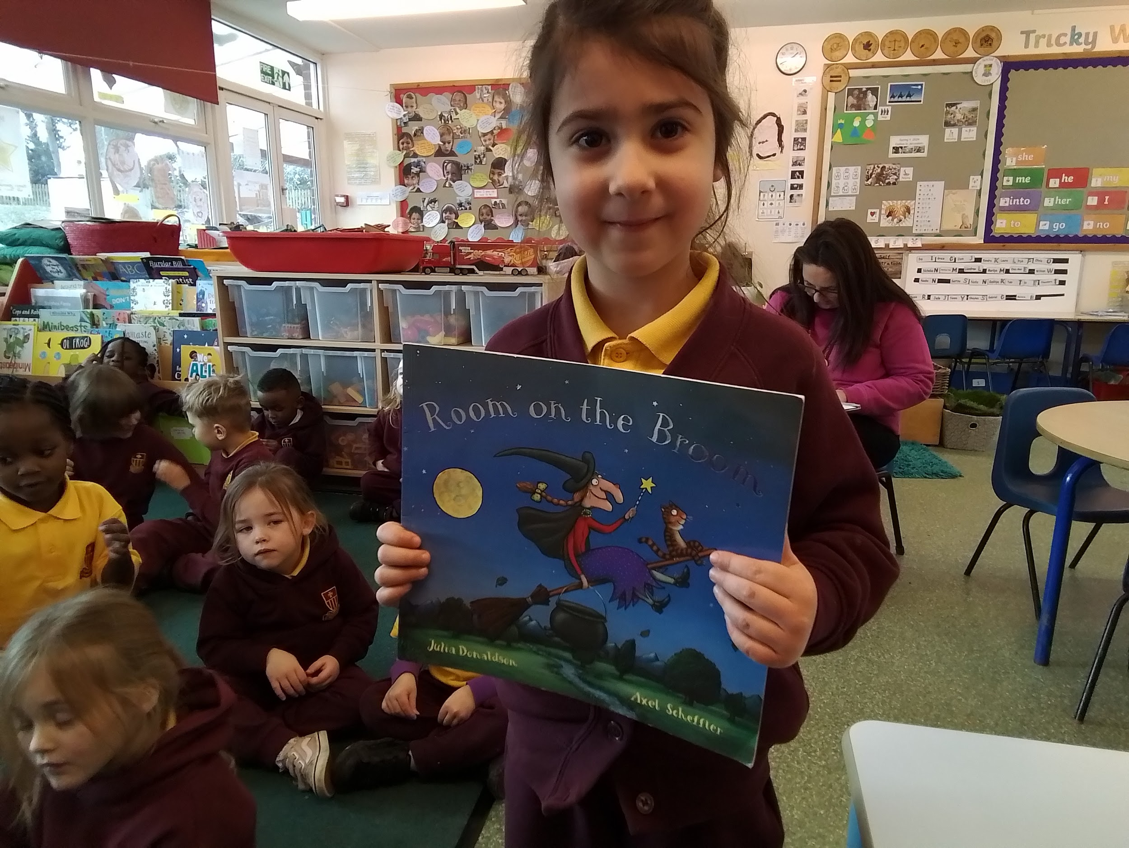
Room on the Broom - I like it because the witch loves animals.

Slide 11
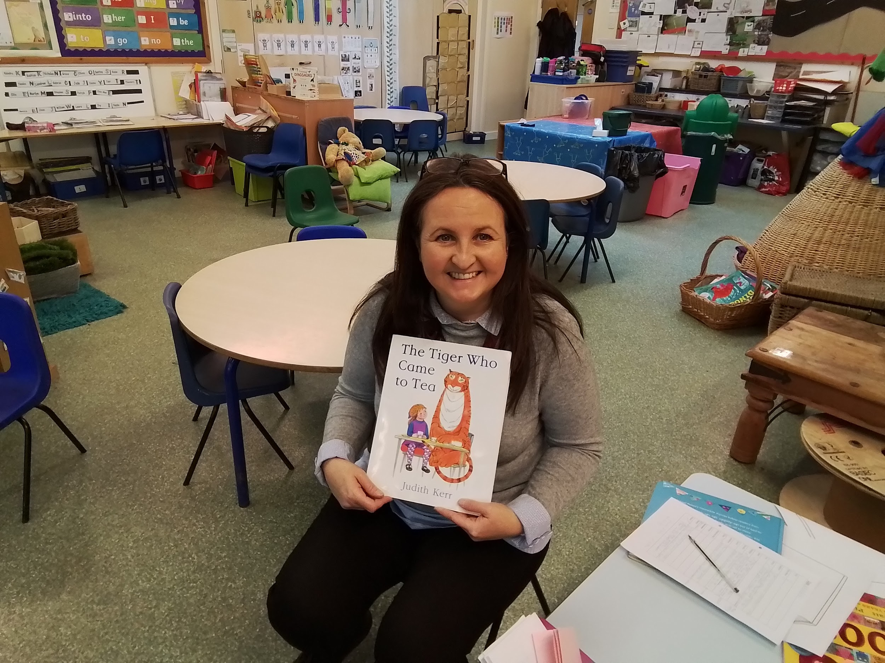
The Tiger Who Came To Tea - I love the way he eats all the food.

Slide 12
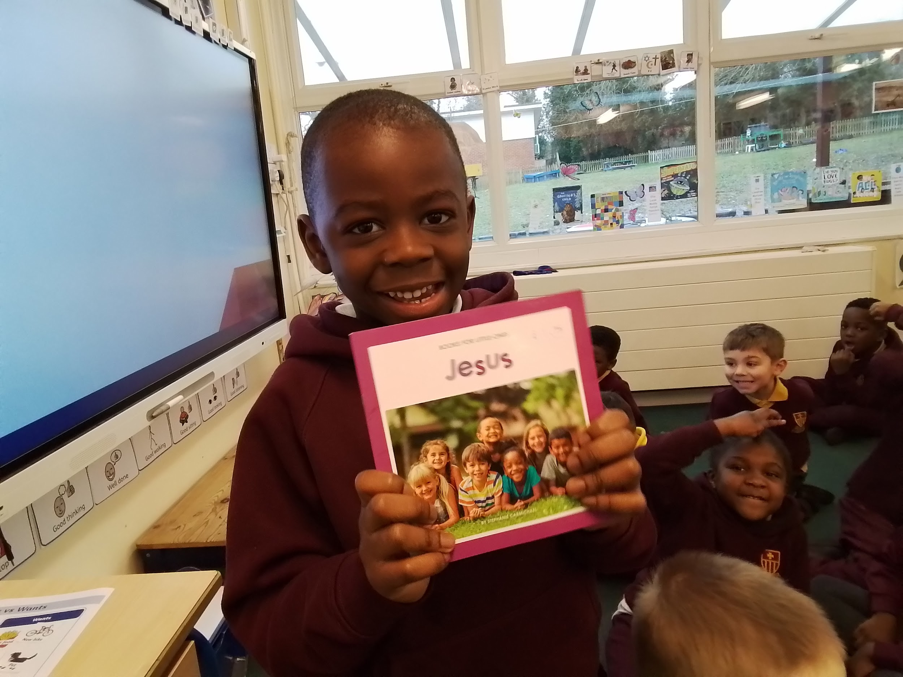
Jesus - There is a Doctor. It tells me about people who help.

Slide 13
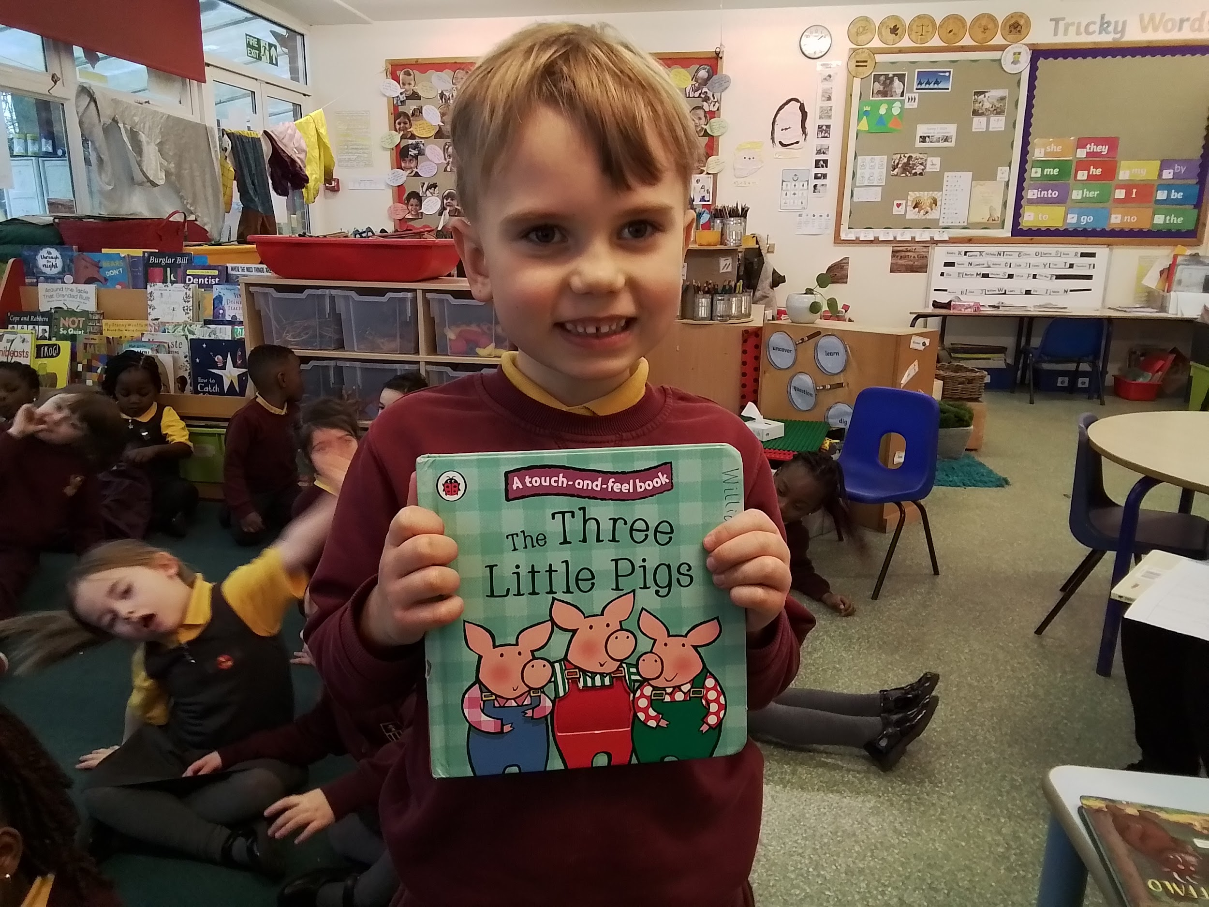
The Three Little Pigs - The wolf eats the pigs.

Slide 14
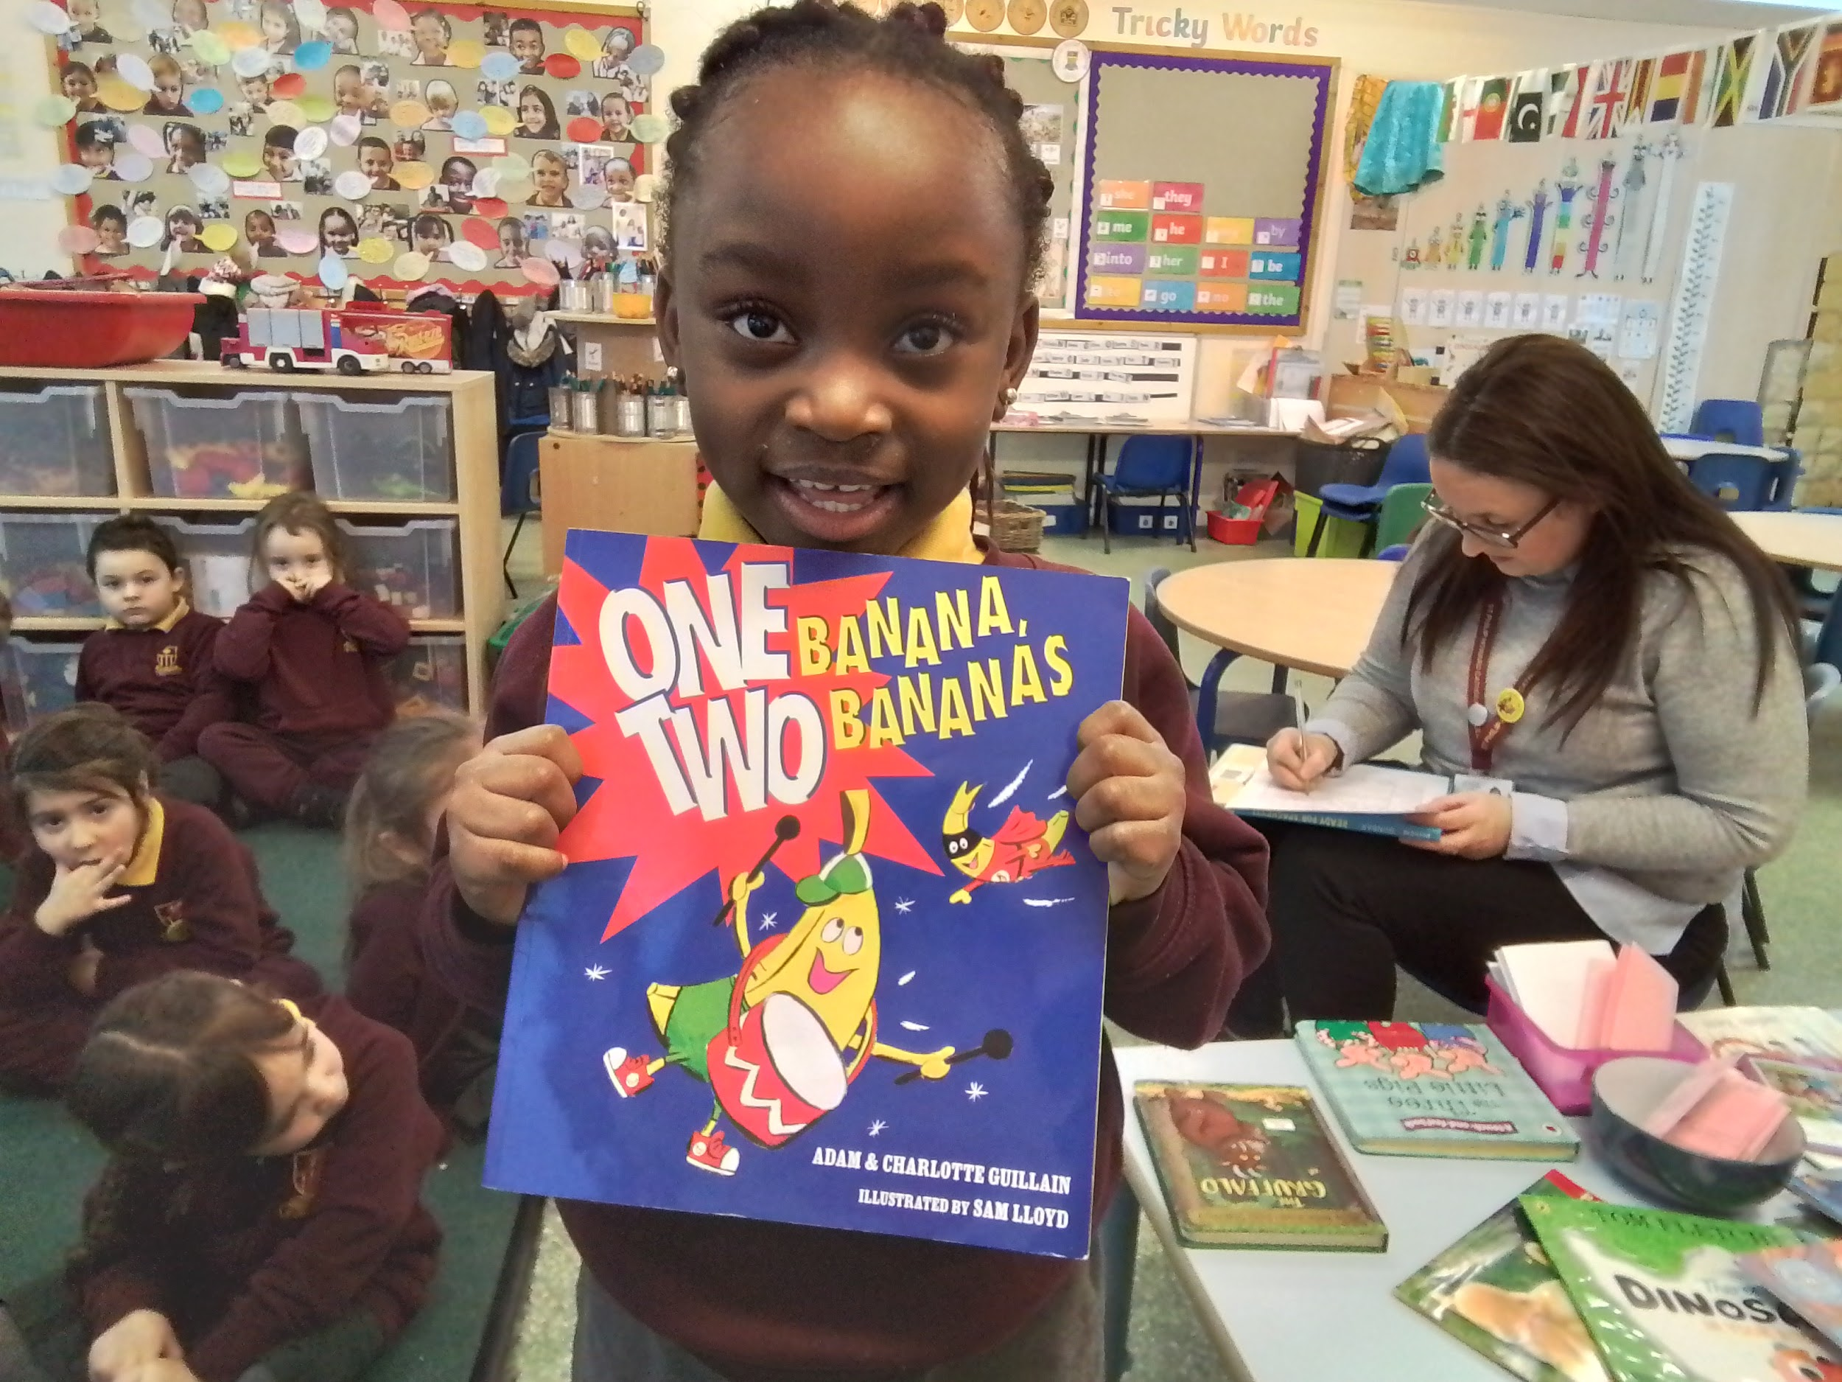
One Banana, Two Bananas - because the monkey wanted to eat a banana.

Slide 15
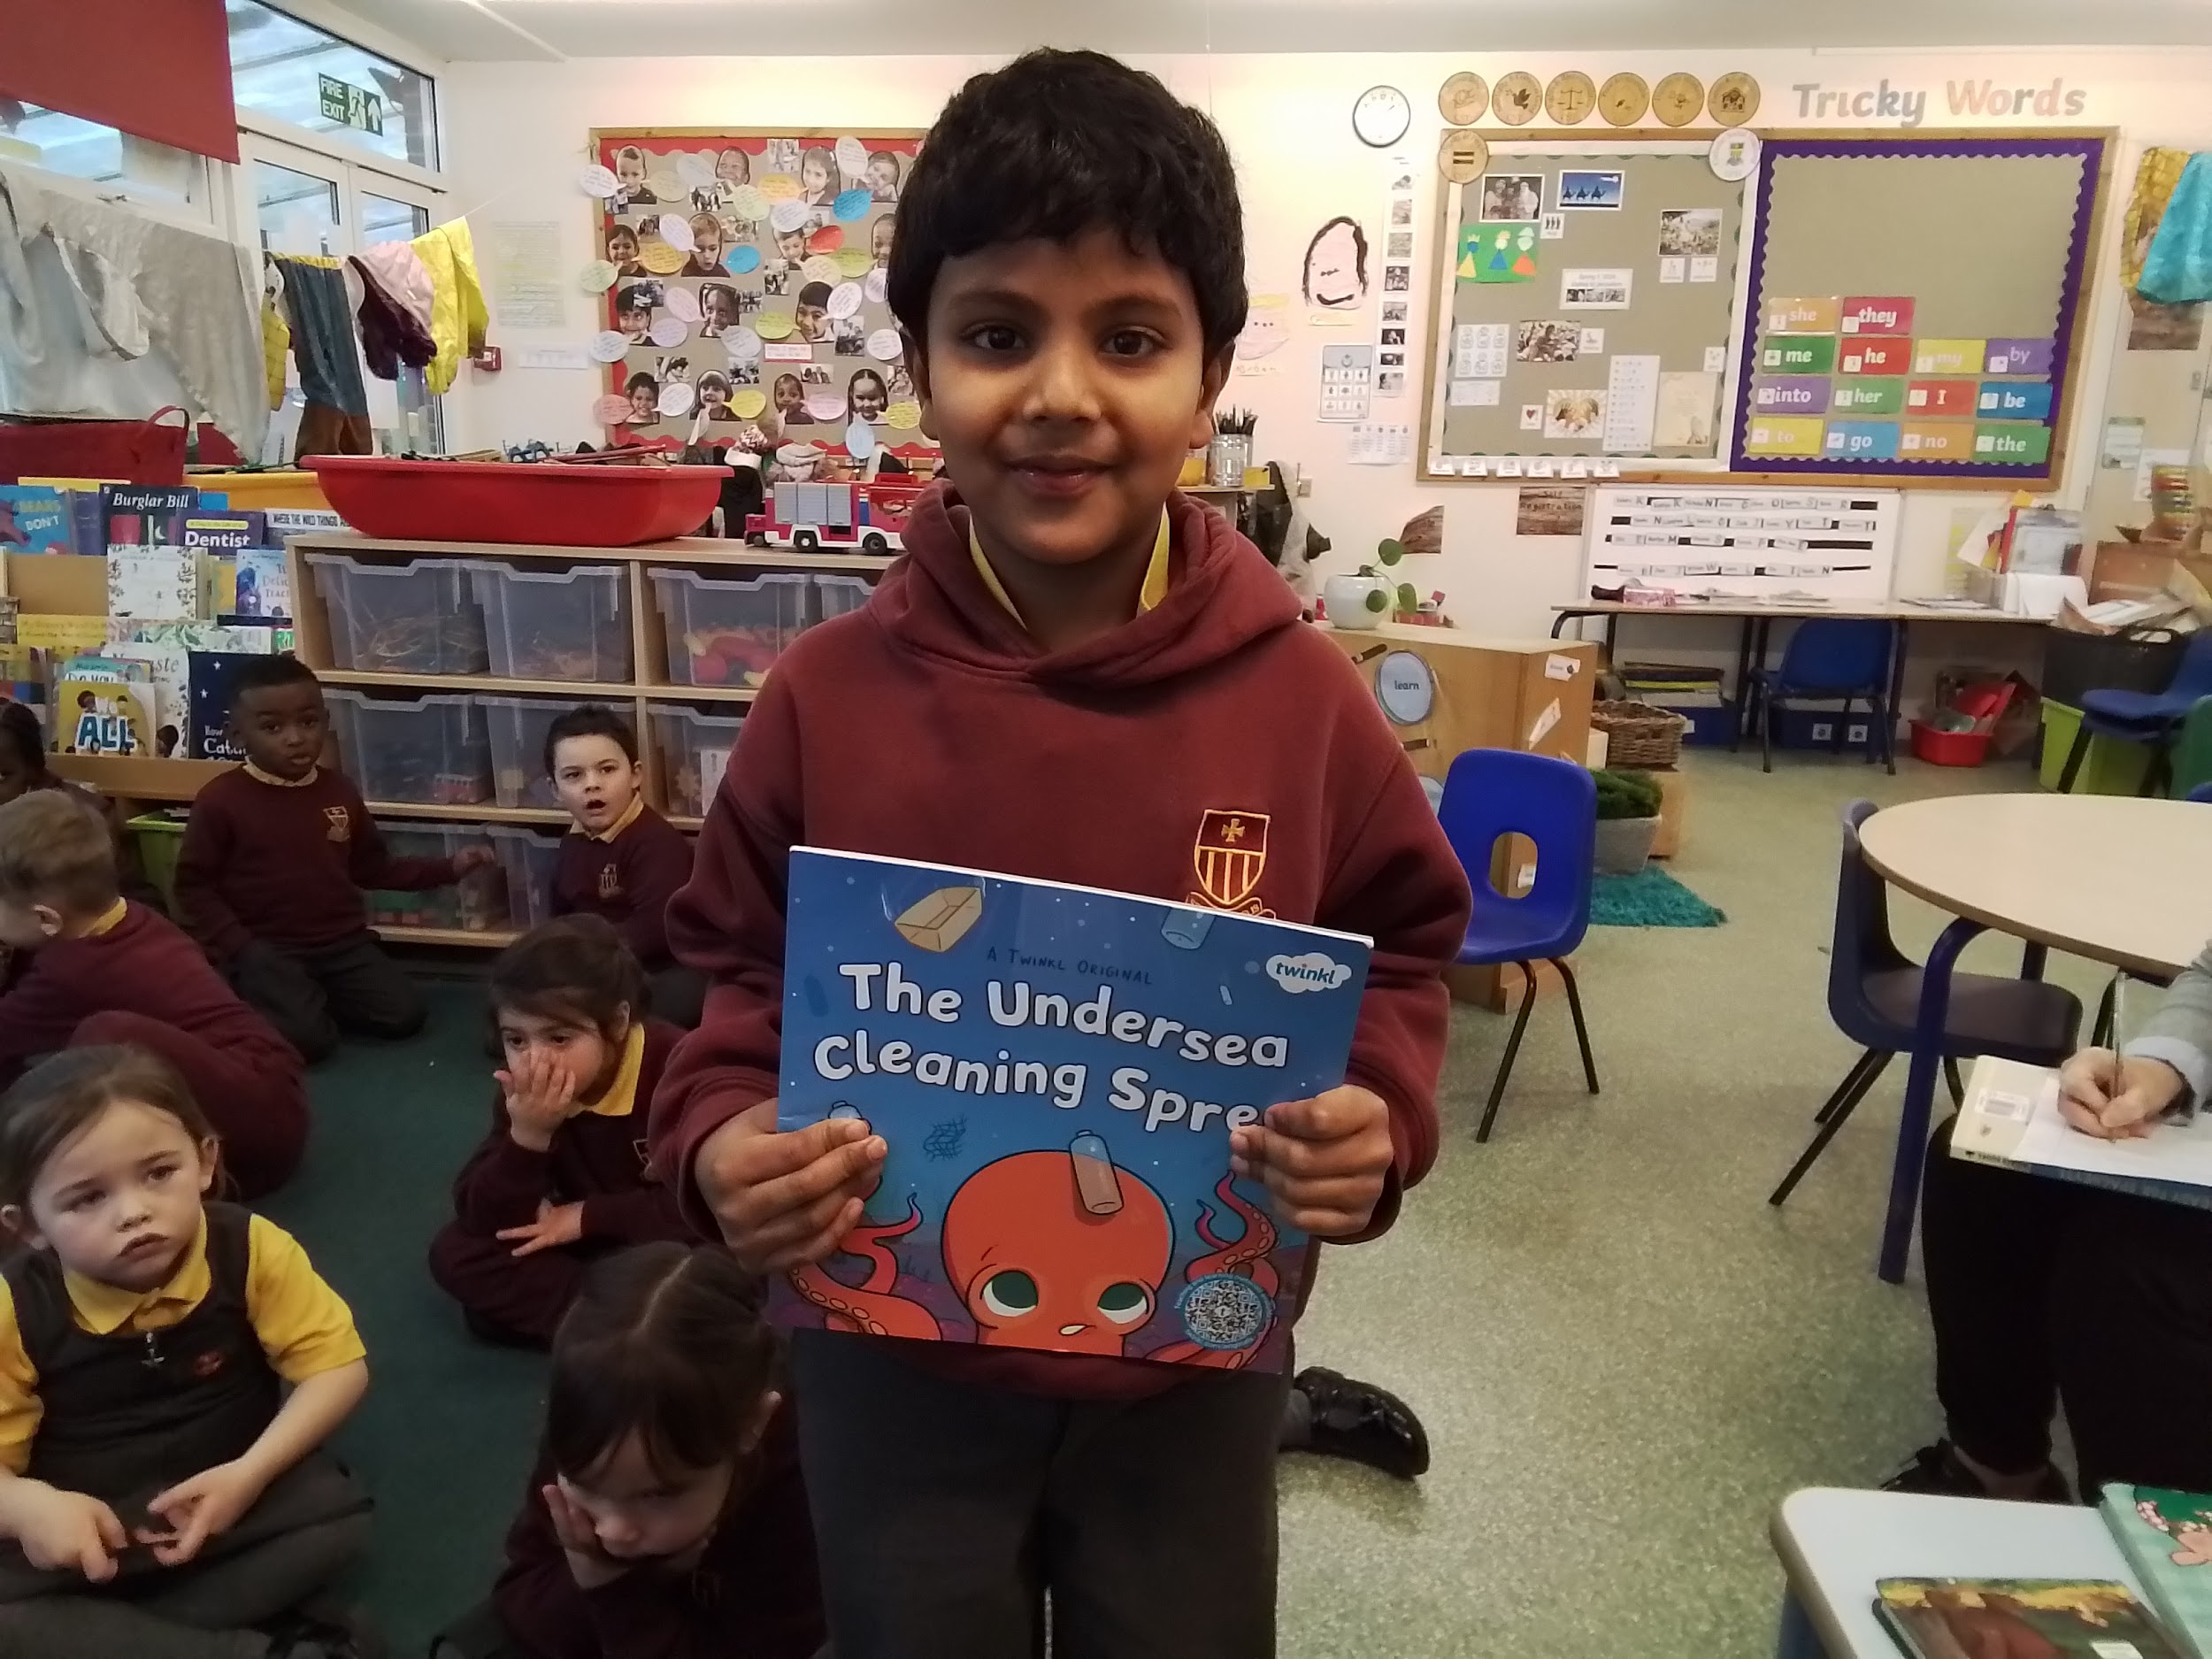
The Undersea Cleaning Spree - it is funny, they get so much rubbish.

Slide 16
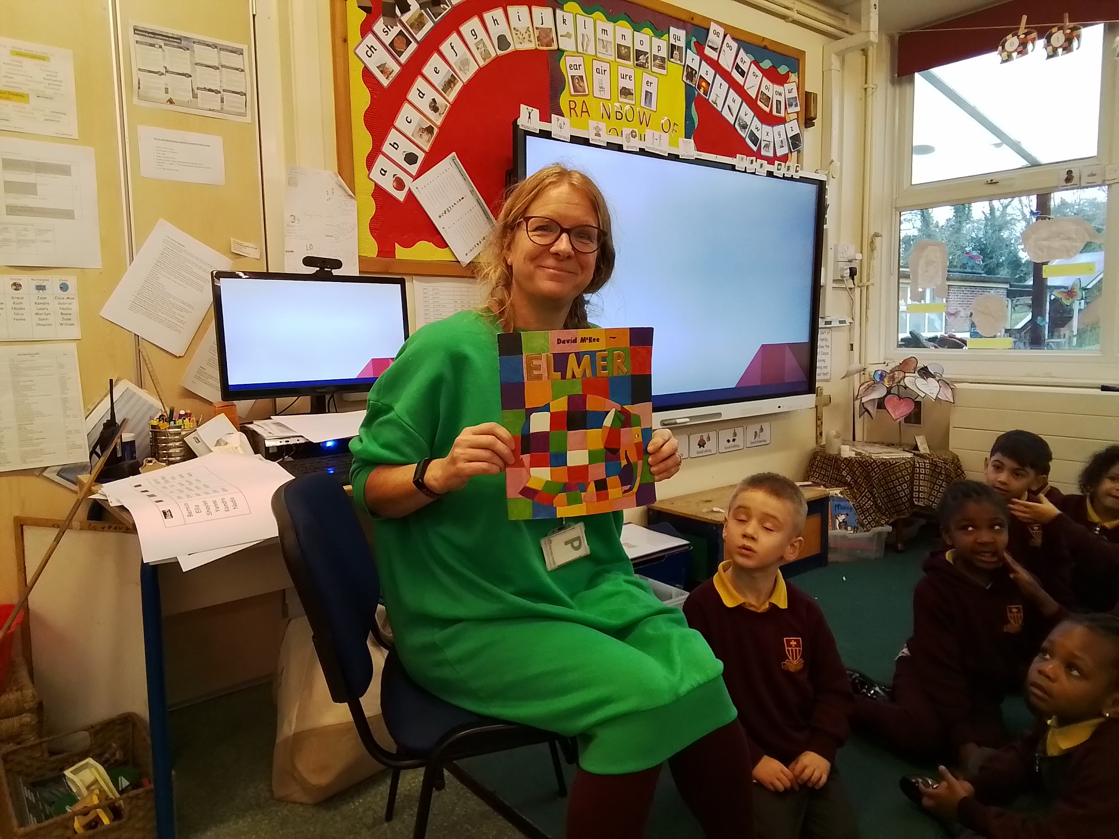
Elmer - Elmer is a little bit crazy, a bit like me!

Slide 17
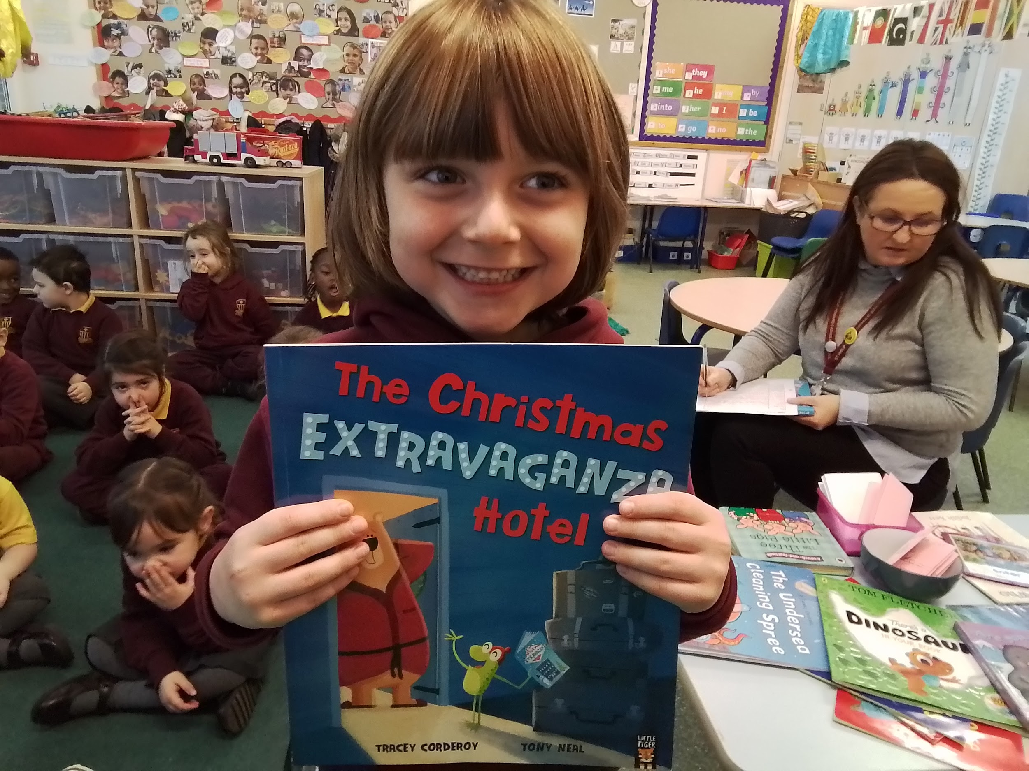
The Christmas Extravaganza Hotel - I like the bear, he’s funny.

Slide 18
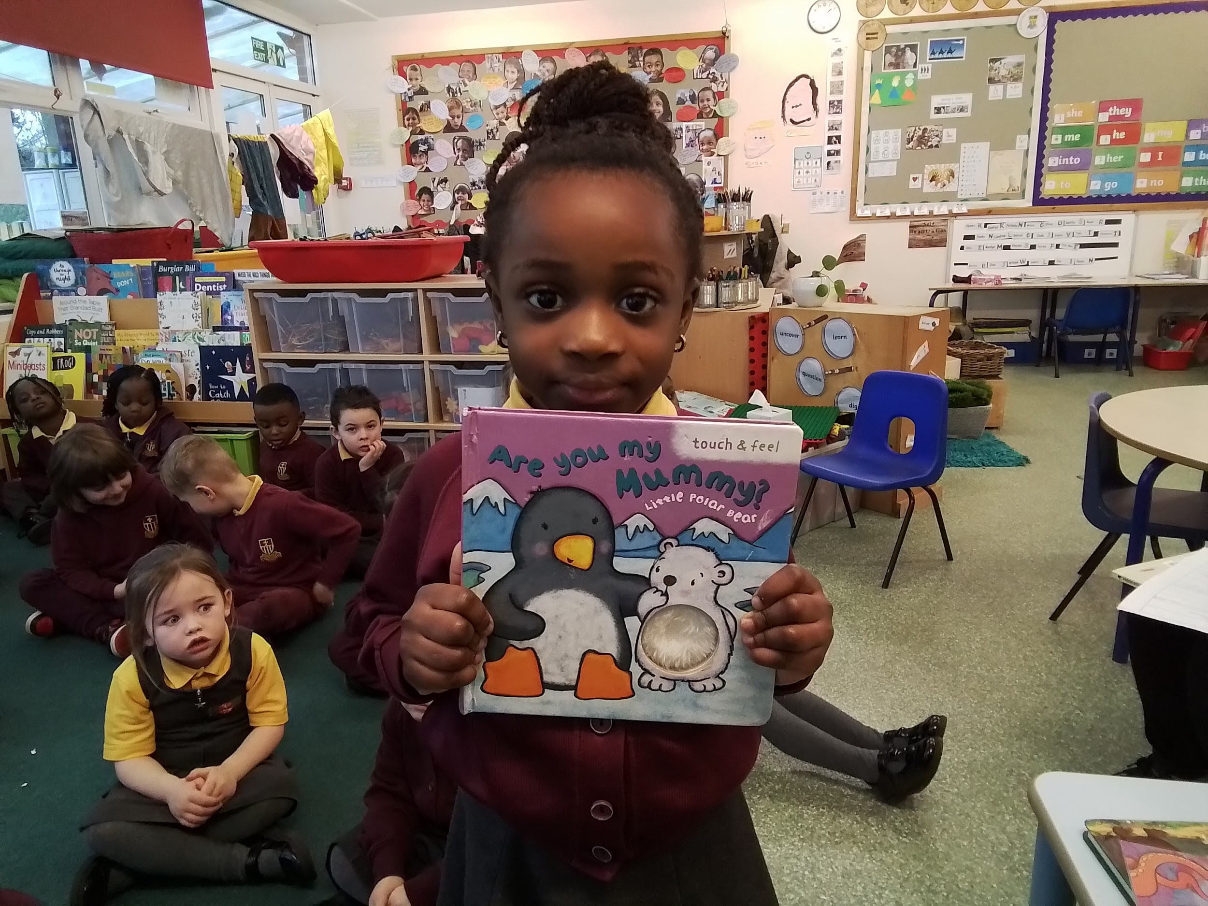
Are you my Mummy? - it makes me feel happy.

Slide 19
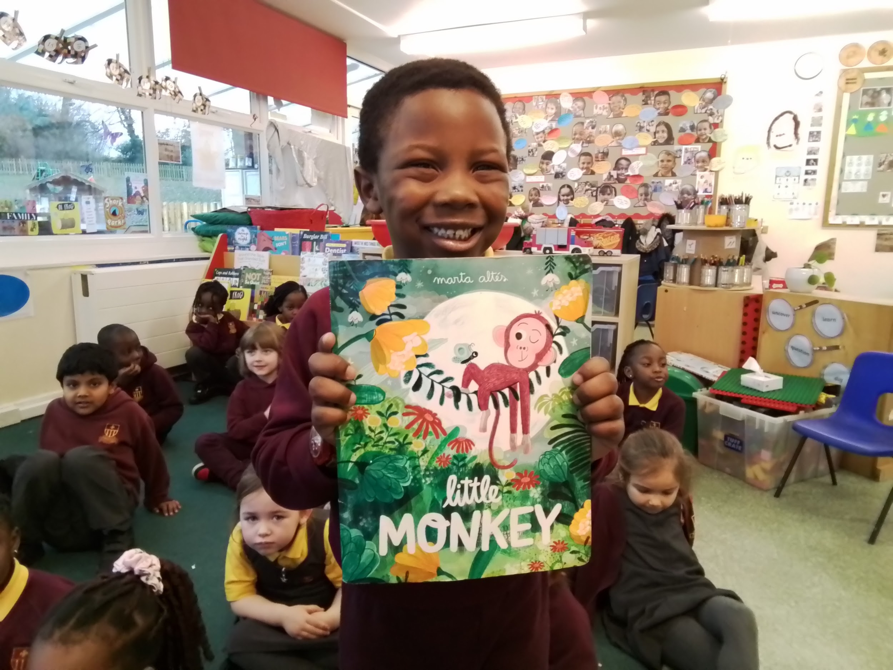
Little Monkey - Little monkey was walking and saw a tiger.

Slide 20
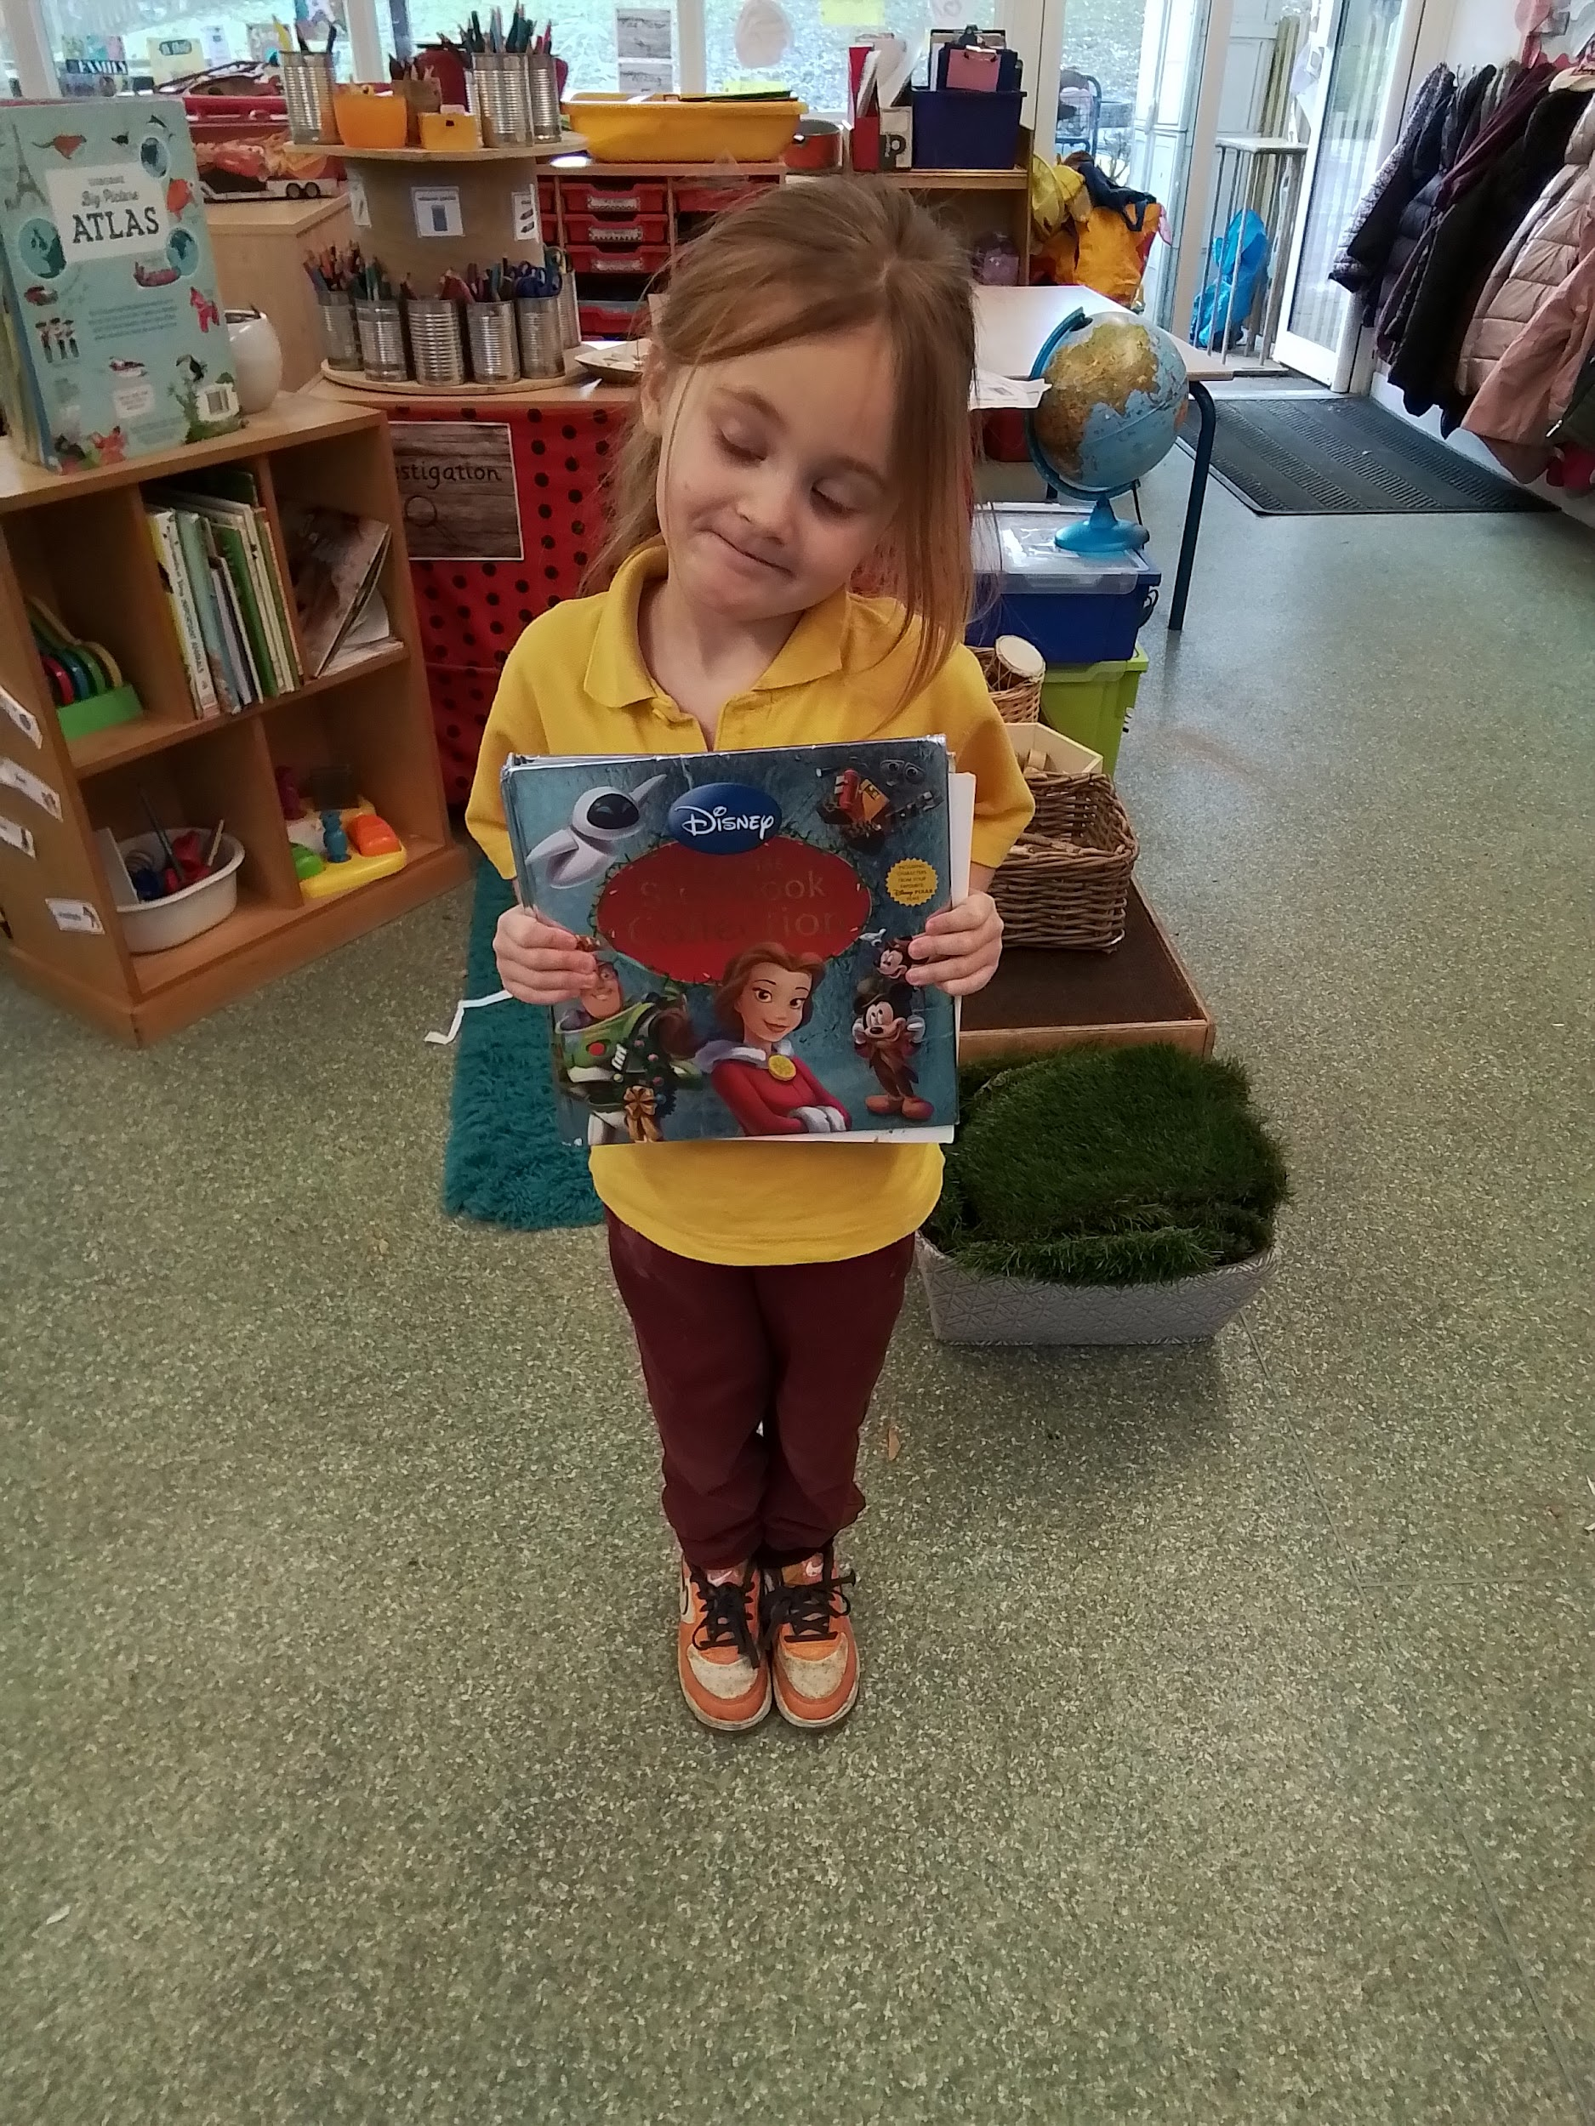
Christmas Storybook Collection - It has all of the Disney characters.

Slide 21
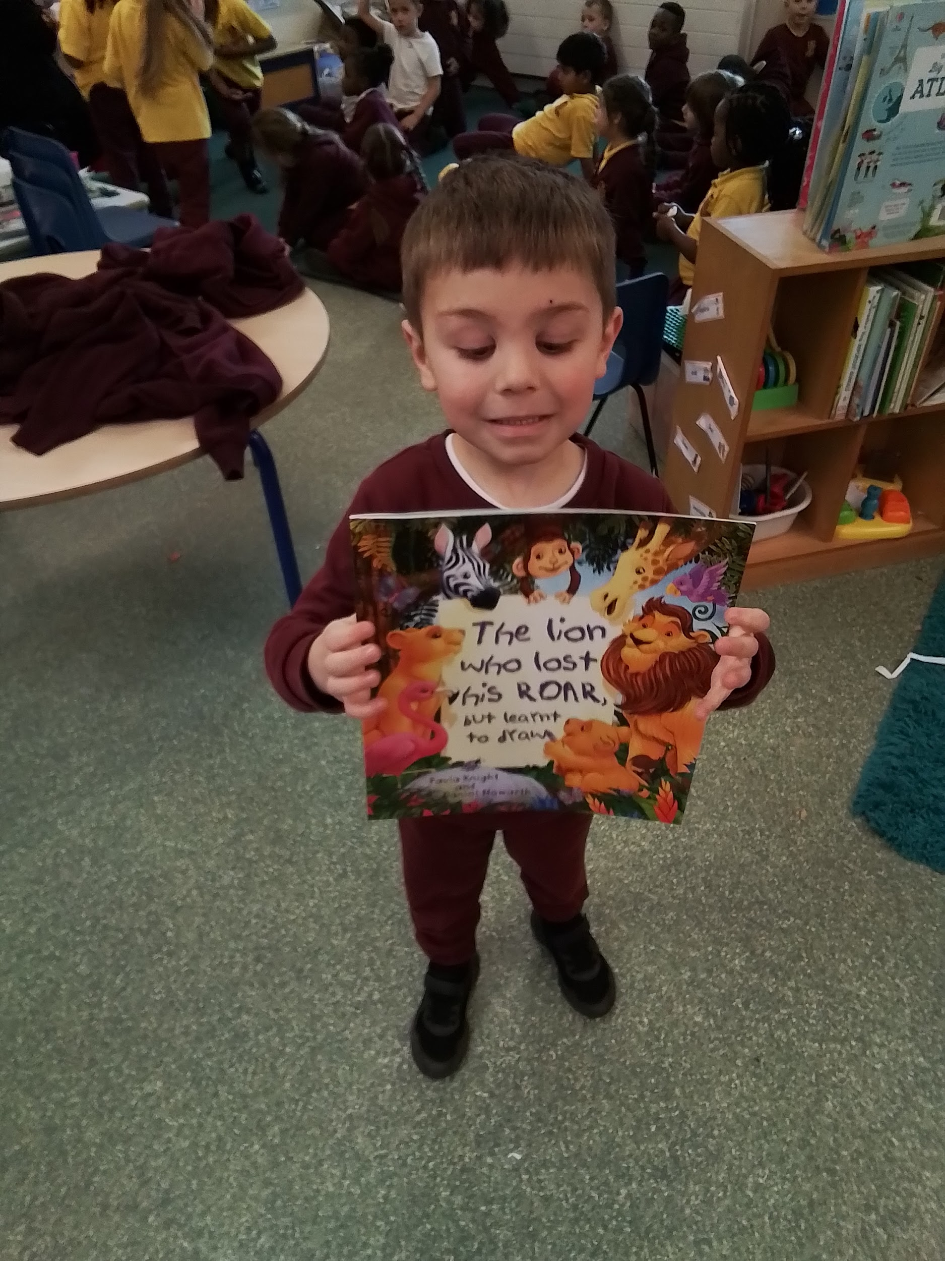
The Lion Who Lost His Roar - I love the lion because he loses his roar.

Slide 22
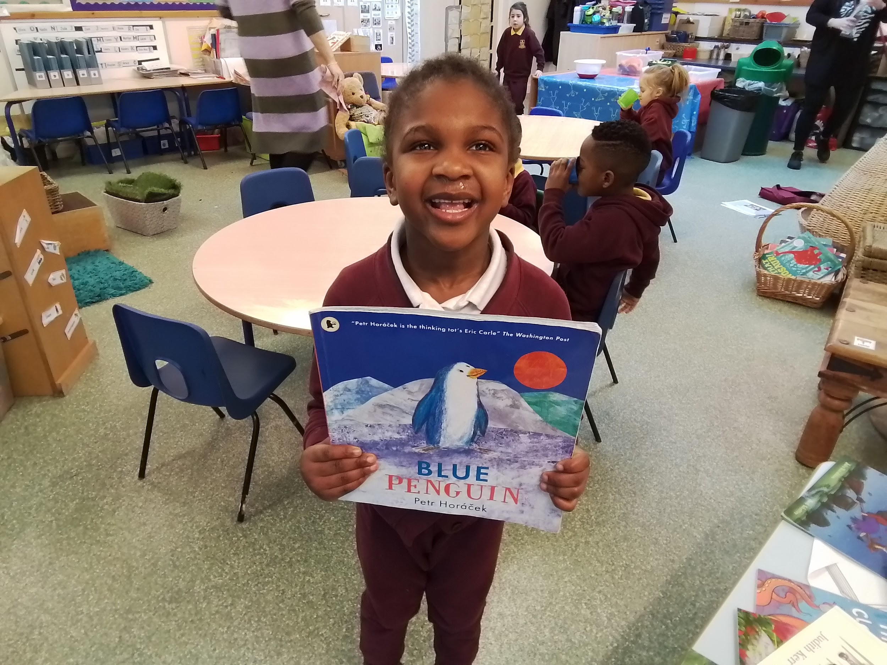
Blue Penguin - When I sleep my Mummy reads it to me.

Slide 23
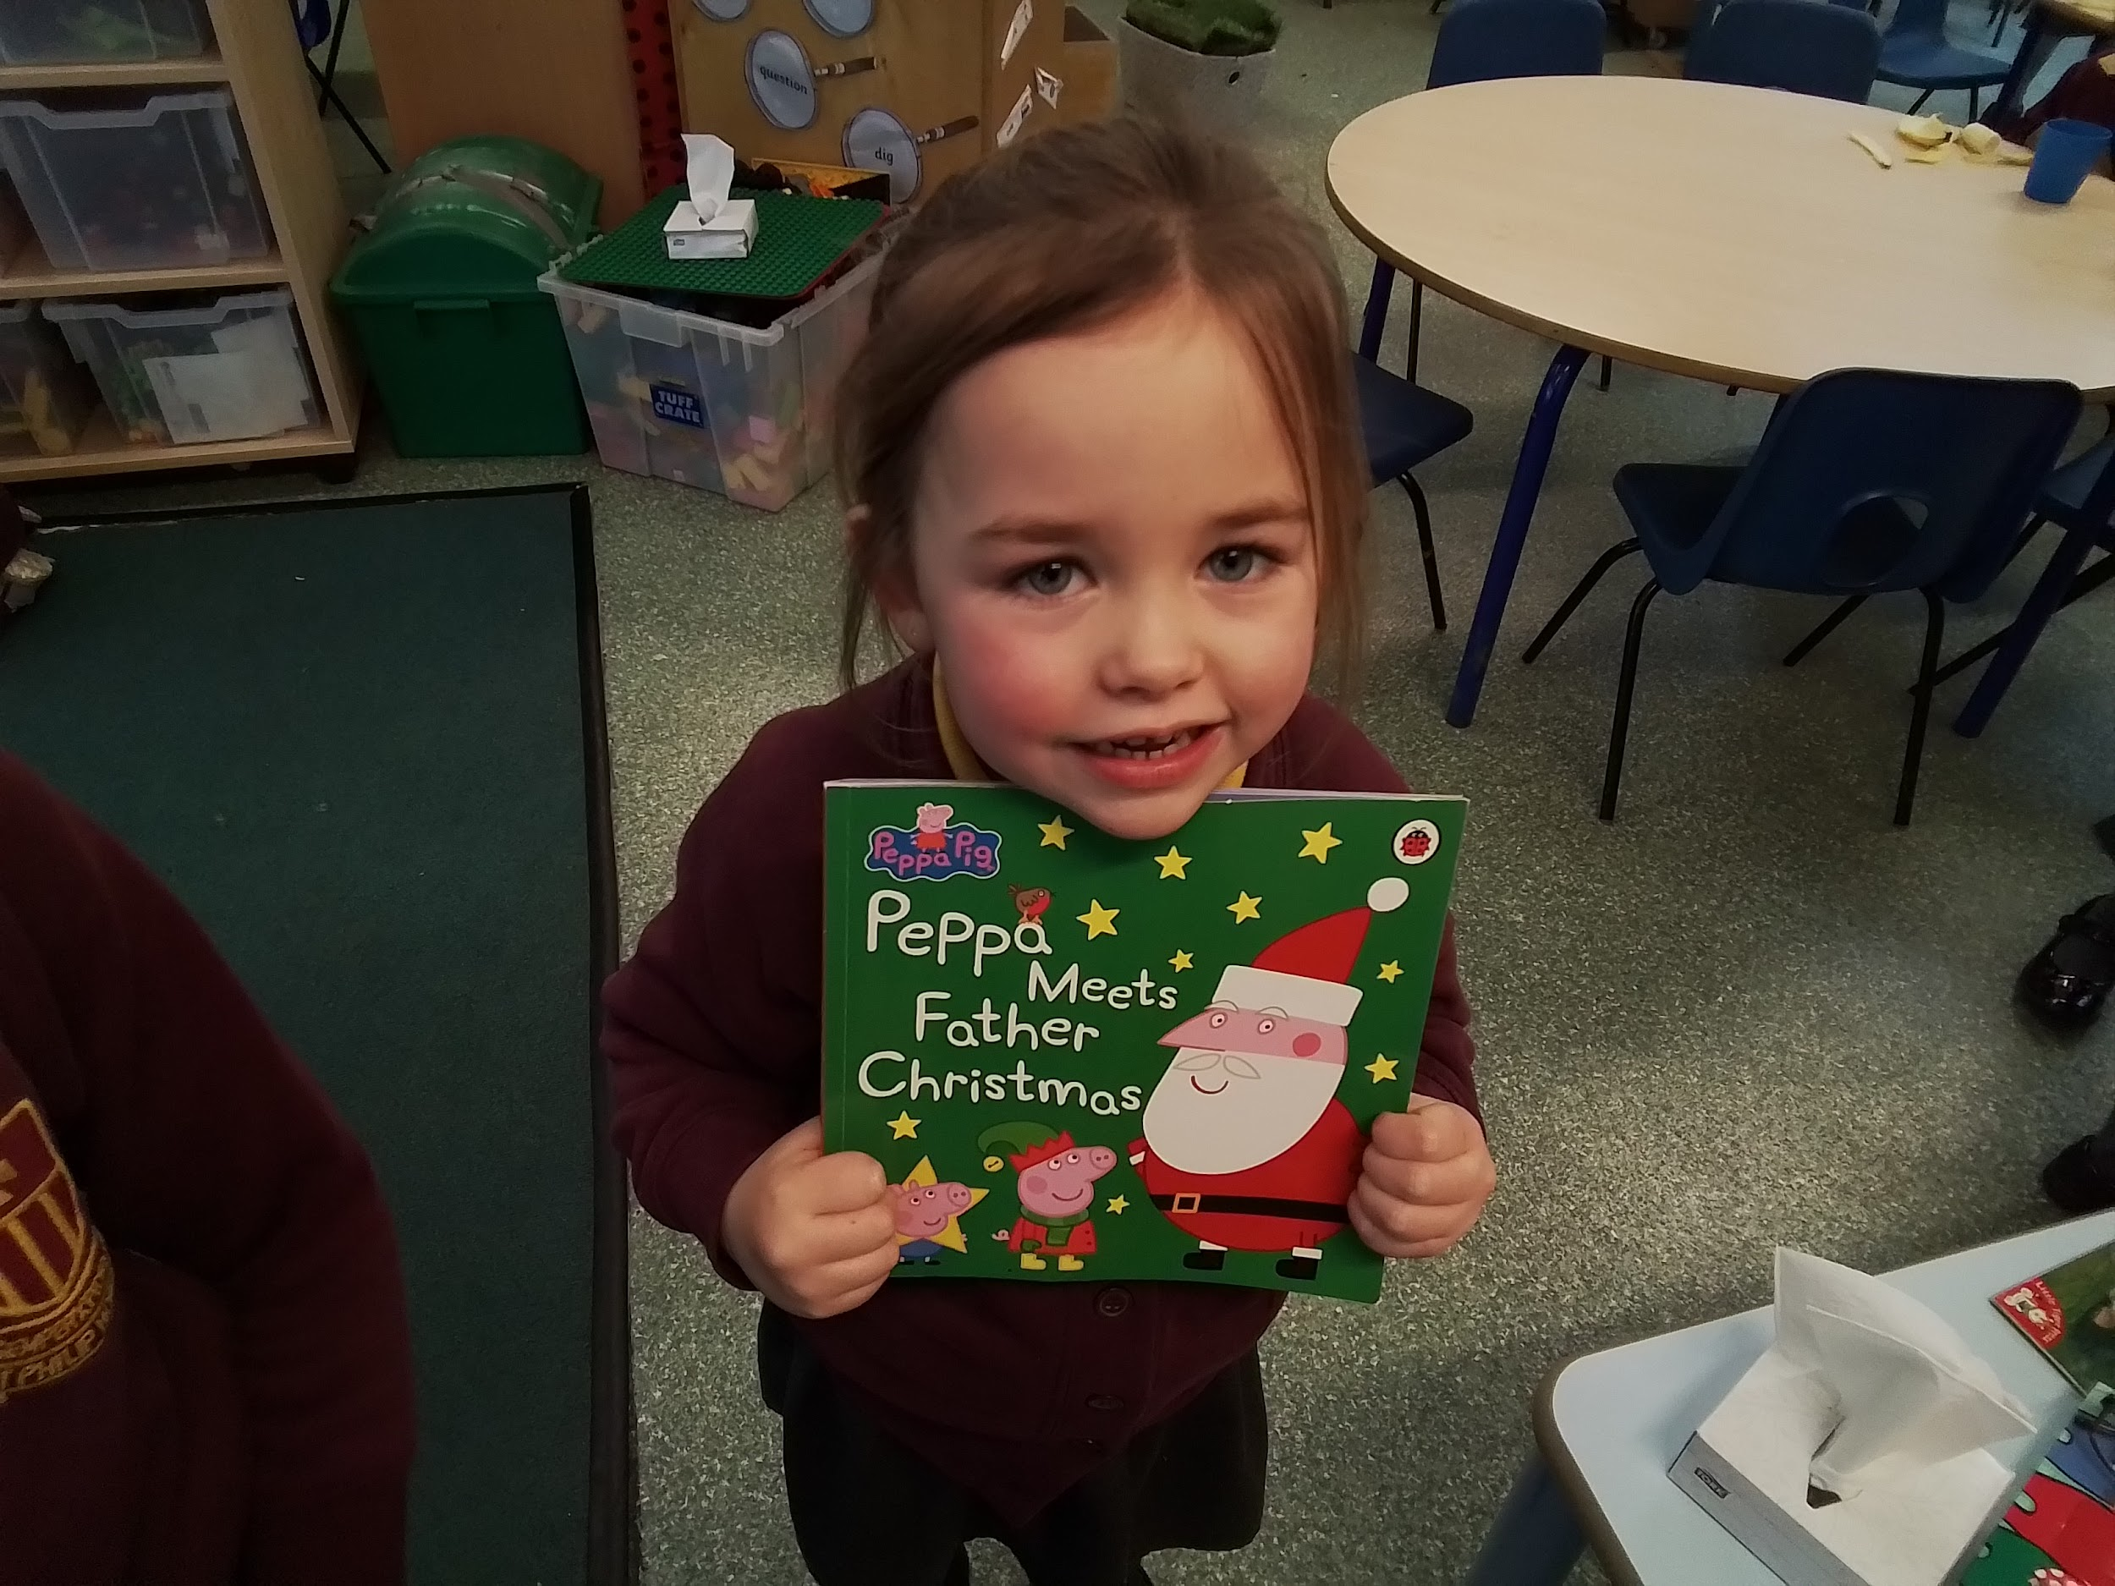
Peppa Meets Father Christmas - I like Peppa seeing Father Christmas.

Slide 24
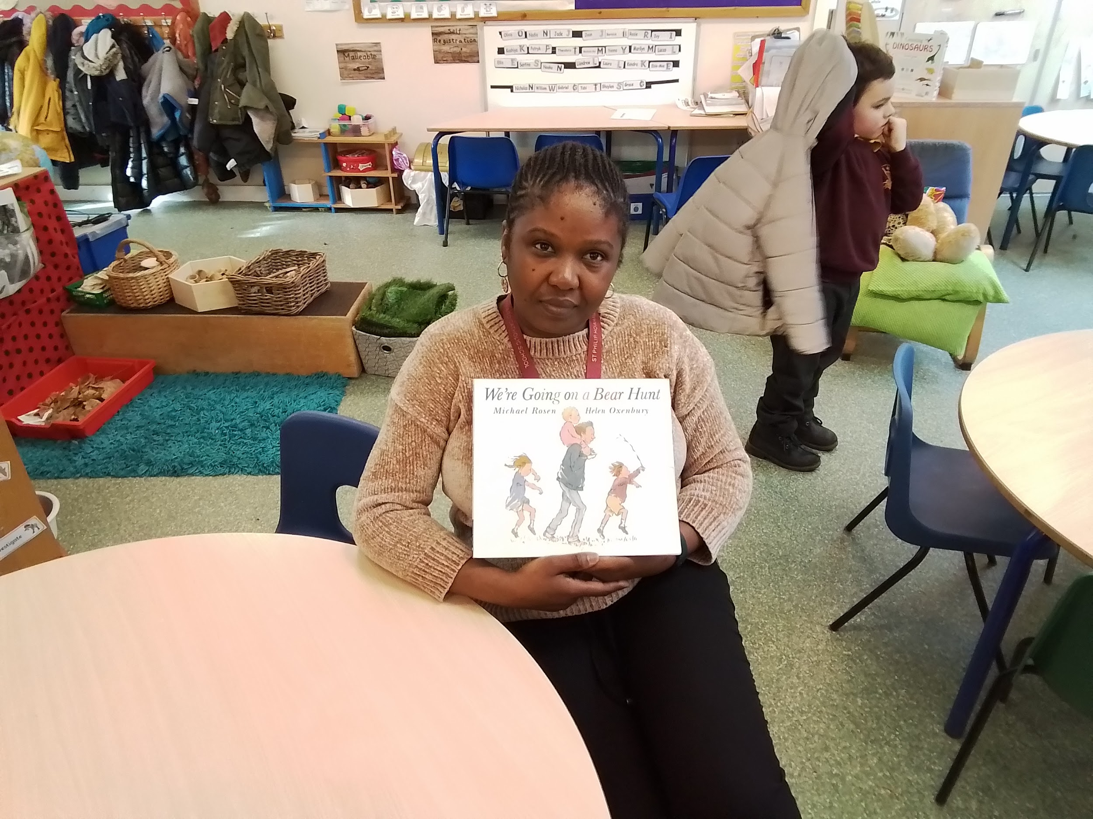
We’re Going on a Bear Hunt - they go on an adventure.

Slide 25
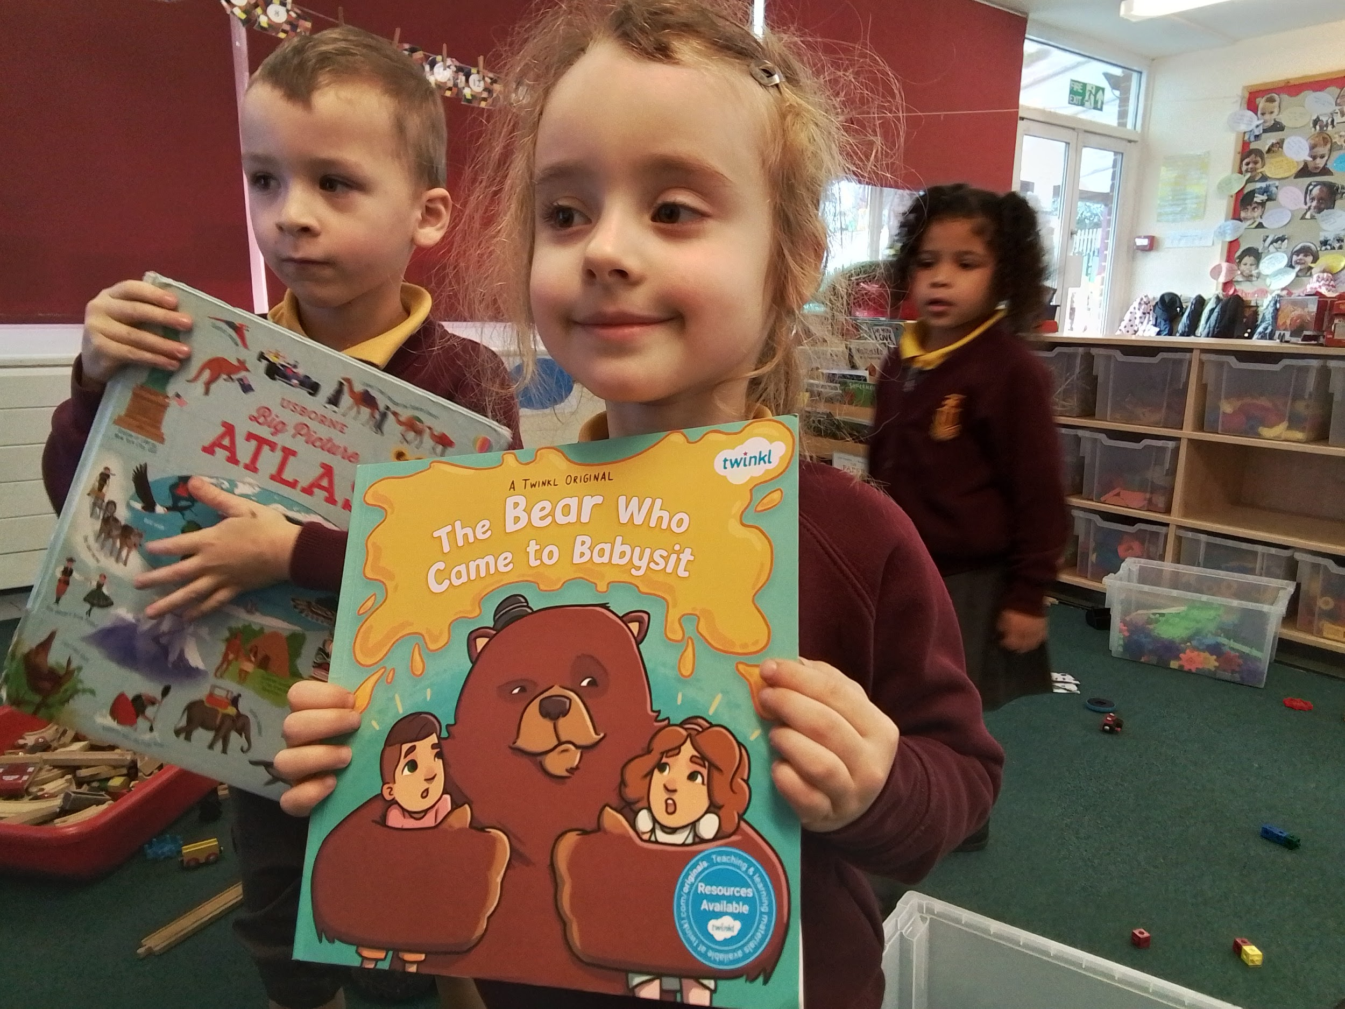
The Bear Who Came To Babysit - The bear goes grrrr.

Slide 26
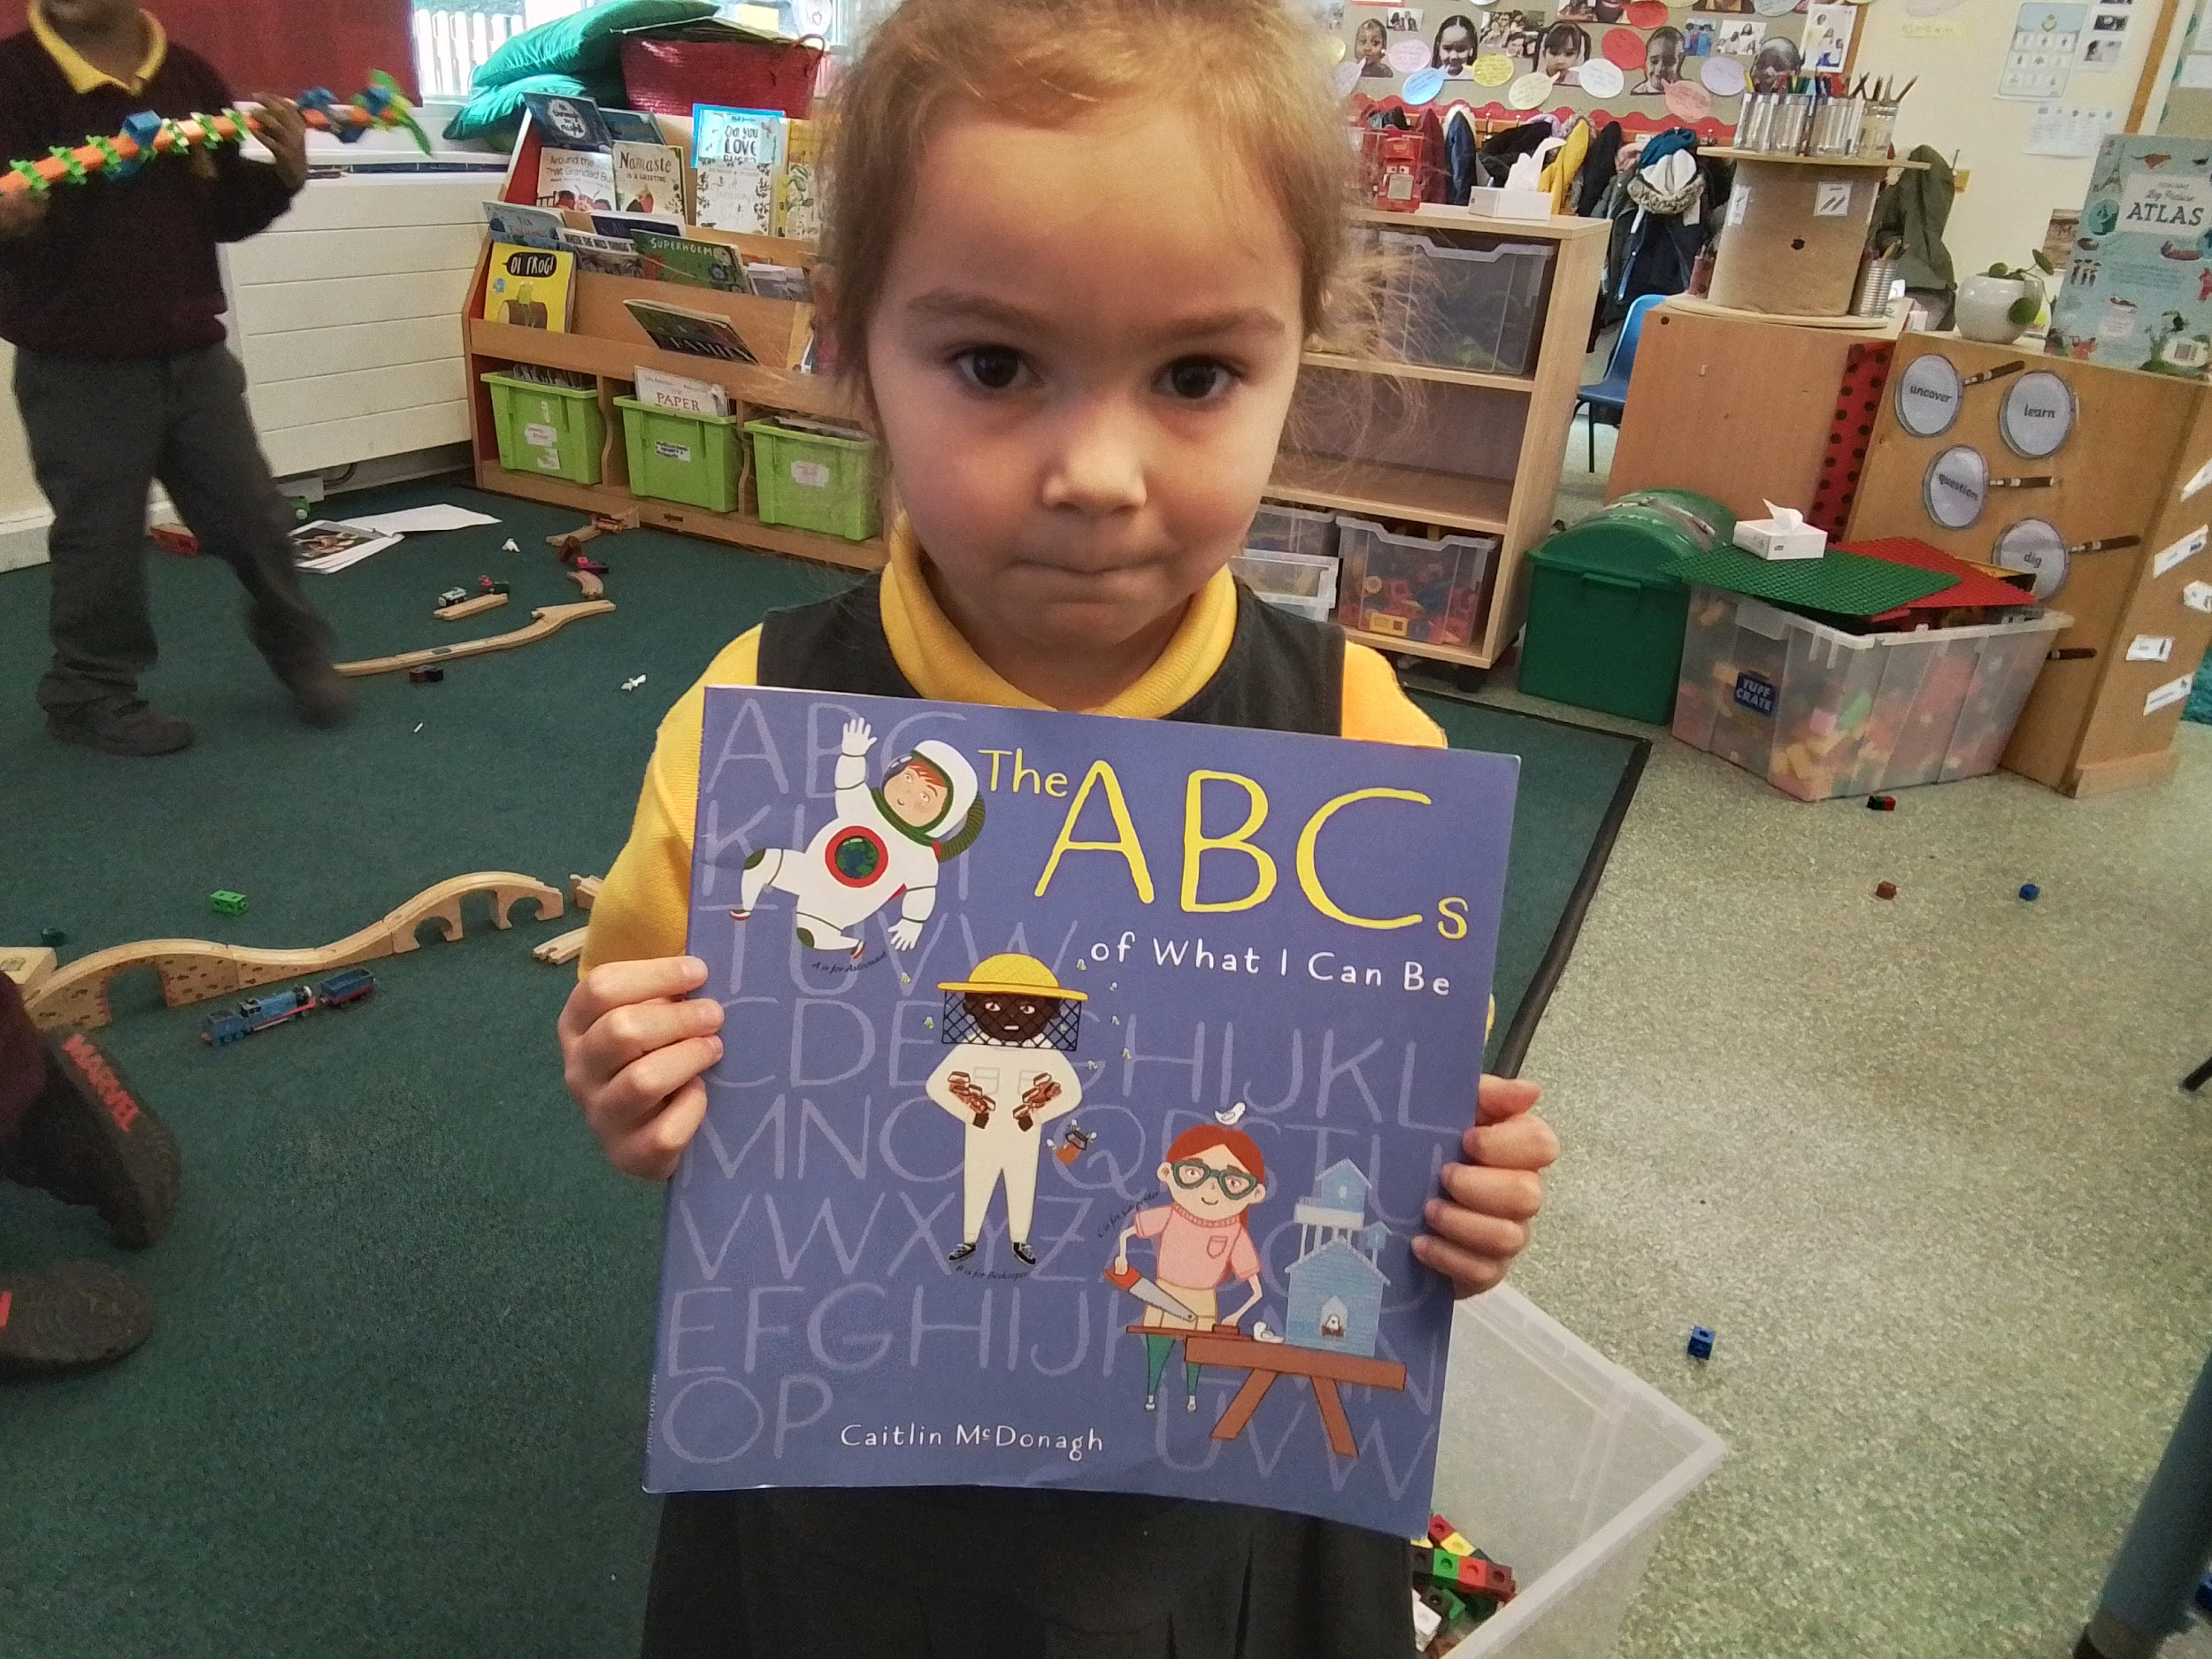
The ABC of What I Can Be - I like the fashion designer.

Slide 27
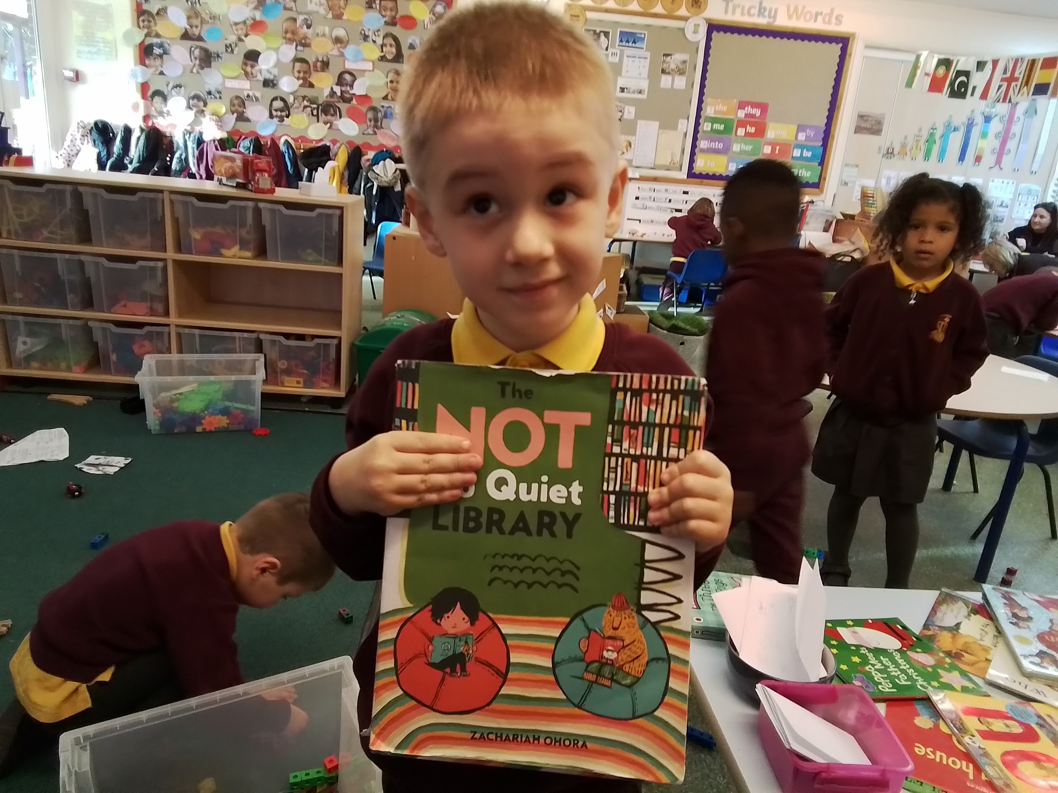
The Not So Quiet Library - I like the monster in the library.

Slide 28
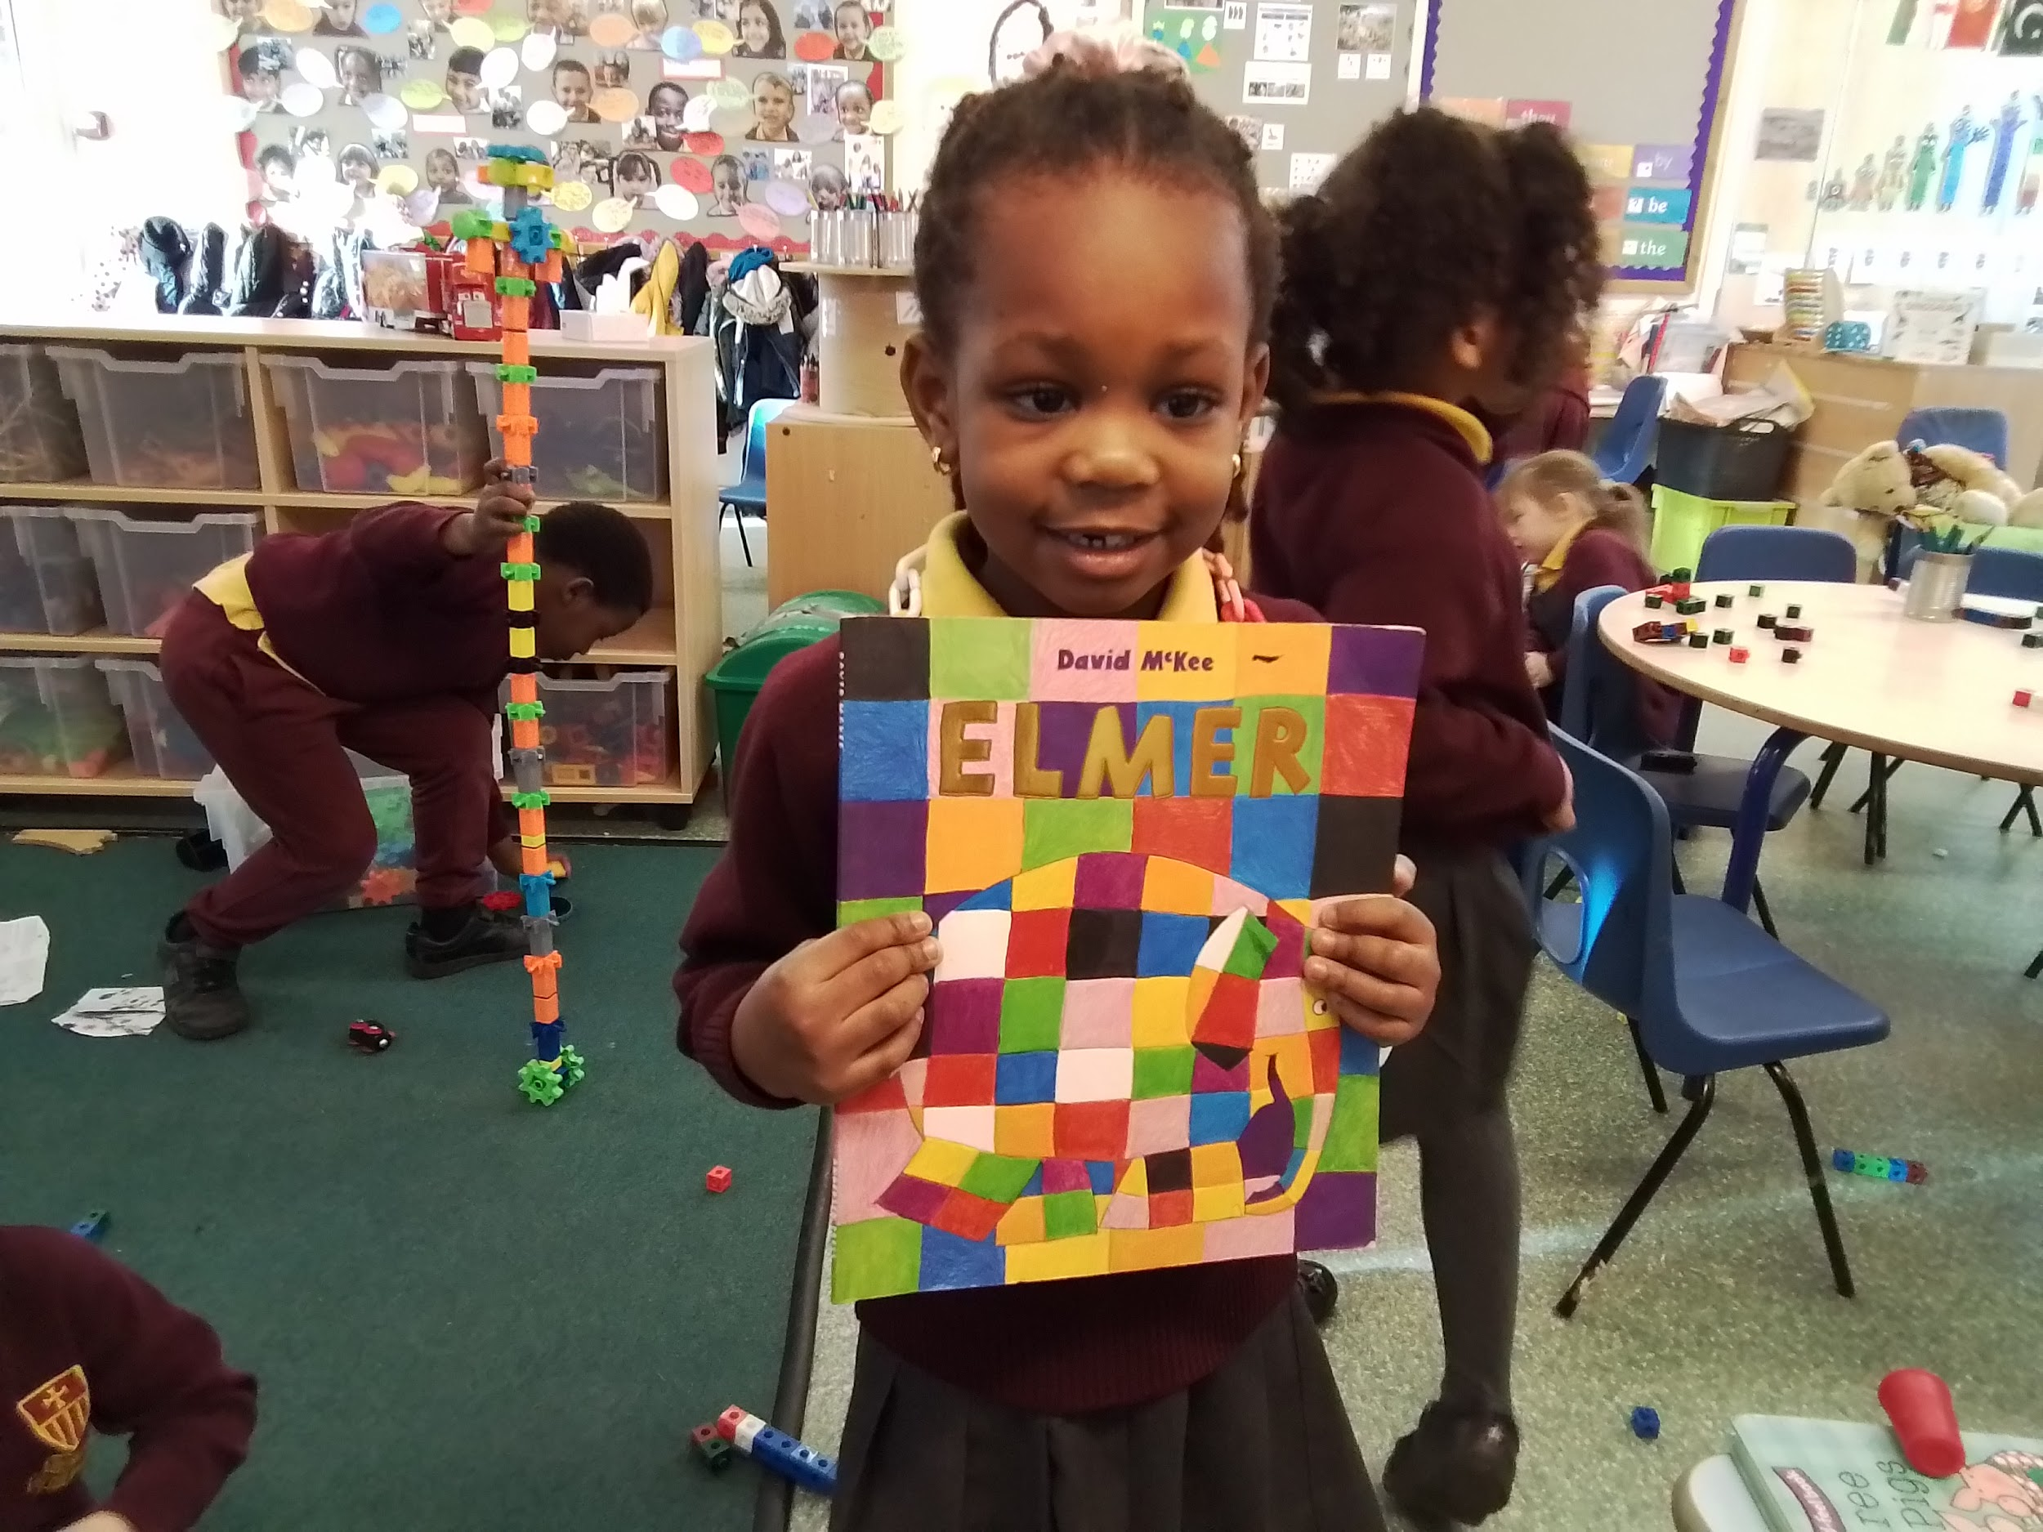
Elmer - It’ so funny.

Slide 29
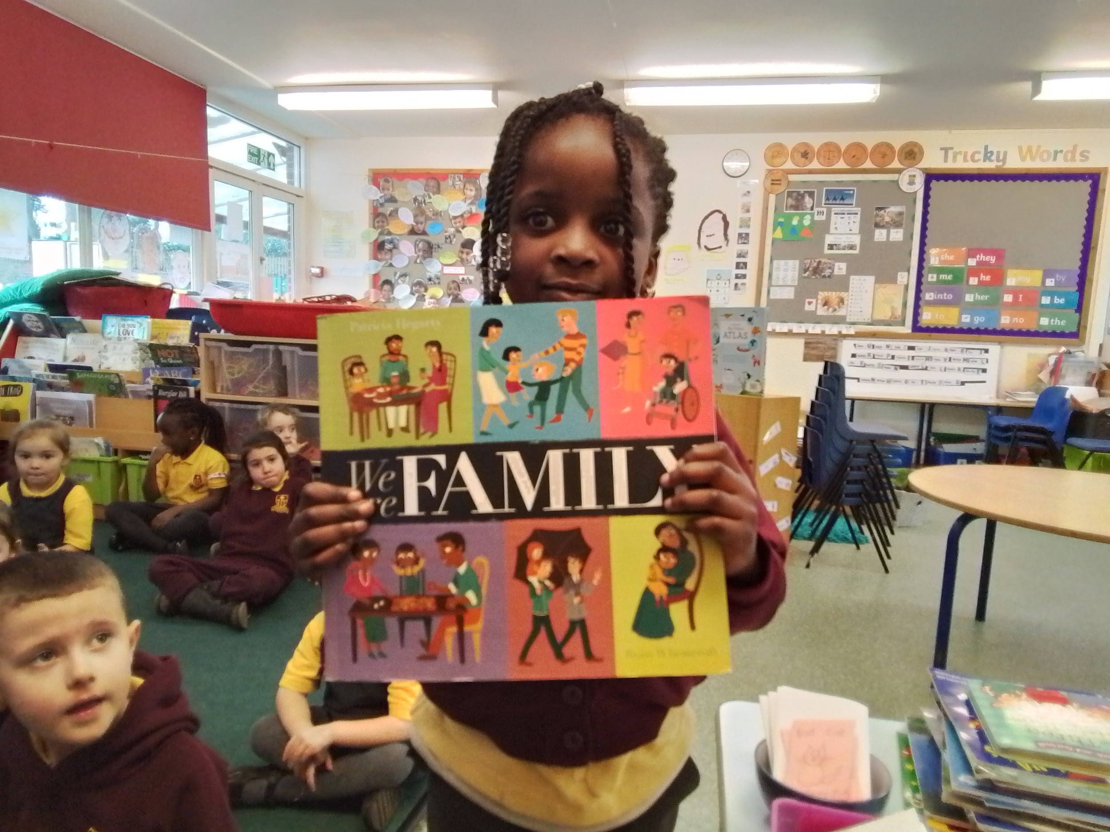
My Family - It’s like a family.

Slide 30
Chicken Little - I like Chicken Little.

Slide 31
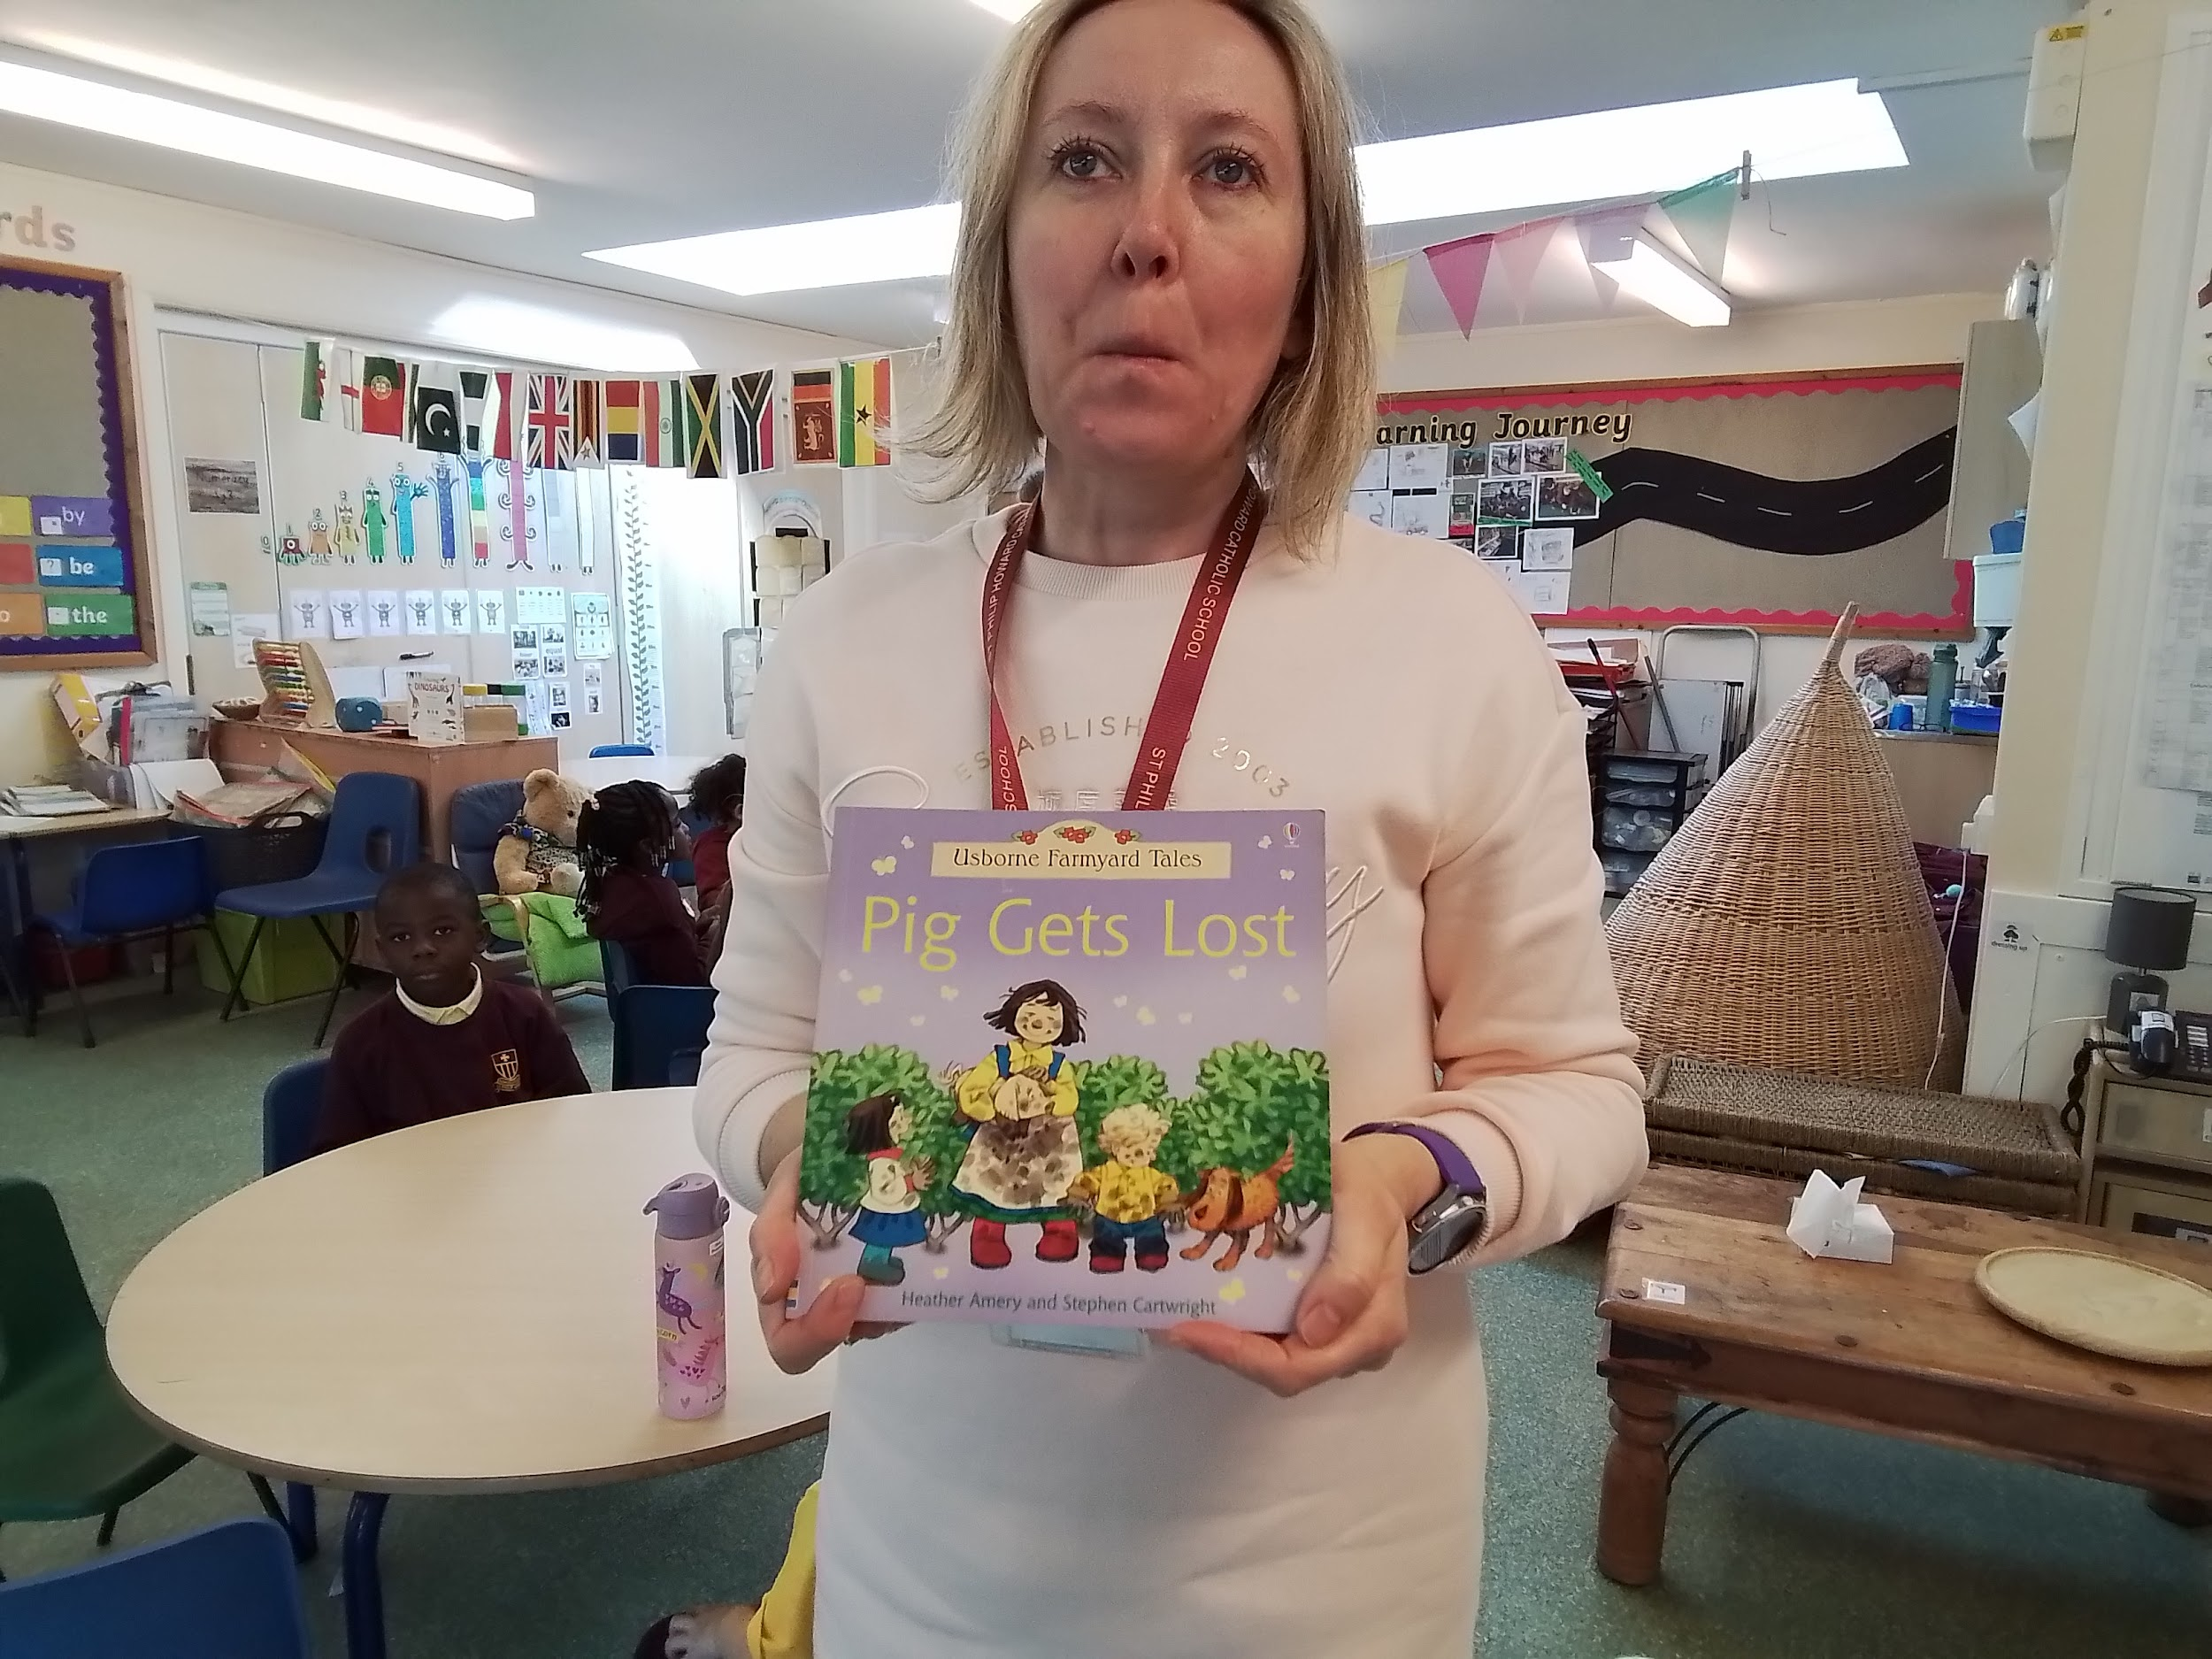
Pig Gets Lost - There is a little duck hiding on every page.

