Slide 1
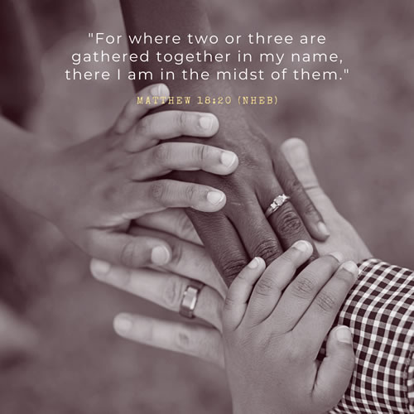

Slide 2

A Parent's Prayer
Lord, we pray for our children knowing that you care and watch over each of them completely.
Please encircle them with your great love and protection. Guide their pathways and walk beside them always. Minister by your Holy Spirit into their hearts and souls and bring your peace.
Bless them with goodness, come open their minds to the wonder and beauty of life.
Sow into their lives great heavenly treasure so they might carry light in their hearts and joy in their spirits.
Lord, may they understand more and more of your love for them.
May they appreciate themselves as you see them - unique and precious.
Father, please come and cover our parenting with your amazing love.
In Jesus name, Amen.

Slide 3

Welcome to Year 6
6S - Mrs Spratt
Mrs Wilkinson
Mrs Sheldrake
6TS - Mr Syme
Mrs Winter
How can you help your child in Year 6?
Curriculum
Homework
Reading
General Points

Slide 4

The Year 6 Curriculum
Our curriculum overview can be found on our class pages on the website. This will keep you informed about what your child will be learning each week.
Also on the web page, you will find knowledge organisers, which will help you support your child in learning key terms and in understanding new vocabulary.

Slide 5
School Website
On our class pages you can find:
A copy of this Powerpoint
Information about what the children will be learning this term
Knowledge organisers for subjects

Slide 6
Website link
https://www.sphoward.herts.sch.uk/Year-6/

Slide 7
New email communication
6S and 6TS
year6@sphoward.herts.sch.uk
Mrs Field (Special Needs Questions and Information)
senco@sphoward.herts.sch.uk
Mrs Waugh, Headteacher head@sphoward.herts.sch.uk

Slide 8
How to help your child’s reading
Reading underpins all learning and it is an essential skill. It happens in all subjects.
We want our children to read for enjoyment but also be able to develop key skills such as reading for understanding.
Guided Reading will take place throughout the week as whole class sessions.

Slide 9
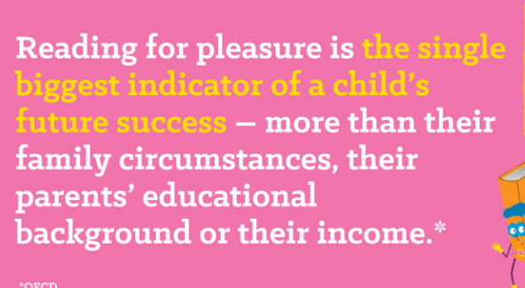
Why does it make such a difference?
Increases their vocabulary
Develops their attention span
Improves their general knowledge
Makes them better writers.
How can you help?
Join the library, it’s free - go online (search ‘Hatfield Library’ & follow the link) or go into the library
If you are a library member you will also have access to free audio books through ‘BorrowBox’. Good for bedtime listening & it develops their vocabulary.
Read to your children and show them that you love books by reading yourself.

Slide 10
Reading At Home
Encourage your child to read for 15 minutes at least 4 times a week at home. It is THE most important thing that supports your child’s education. It will help them to be a successful learner at secondary school. We expect this to be noted in the reading records with a signature from an adult.
Find a suitable time that fits in with their routine.
Show an interest in what your child is reading by asking questions and expect them to read with fluency.
Encourage reading for pleasure.

Slide 11
Spelling
On the website and in the pack provided, you will find the statutory spelling lists for Years 3/4 and Years 5/6.
These can be used at home to support your child with their spelling.
Your child will also have access to their
Spelling Shed which they can access at home.
Your child will have a weekly spelling lessons accompanied by spelling homework practising the sa.

Slide 12
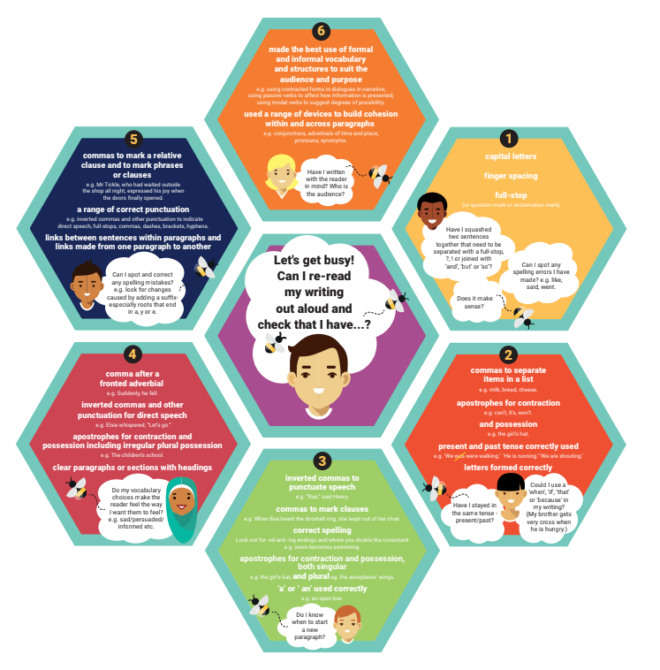
English

Slide 13
Maths
Secure knowledge of times tables is essential in Year 6. It helps in every aspect of Maths.
Your child also needs to be confident with written methods for the four operations - addition, subtraction, multiplication and division.
Your child will also have access to MyMaths and work will occasionally be set on here.

Slide 14
Homework
As children are preparing for Secondary school, their homework will look slightly different. They will no longer complete half termly homework grids. Homework will be given on a Friday, to be returned the following Friday.
Google Classroom
Occasionally, additional tasks will be set on Google Classroom.
https://www.sphoward.herts.sch.uk/

Slide 15
Homework contd.
Maths/SPaG
Each week, children will be given paper maths homework and grammar homework. These will be based on their learning in class. They have a homework book to complete their work and this will be marked in school.
As children progress through Year 6, they may be given additional activities and this will include SATs revision.
Pack and CGP books

Slide 16
Attendance
Your child’s progress is greatly helped by good attendance. School starts at 8:40am and finishes at 3:15pm.
Early morning work is an important part of the school day (including interventions).
Registers are taken by 8:50am. Your child will be marked as late after this.

Slide 17
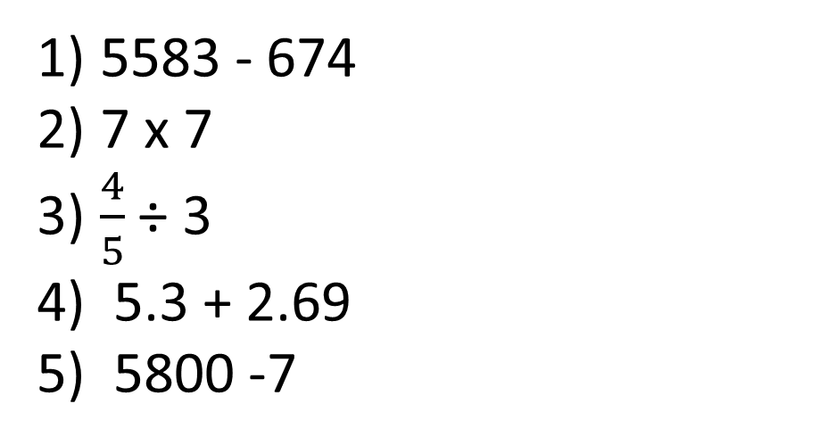
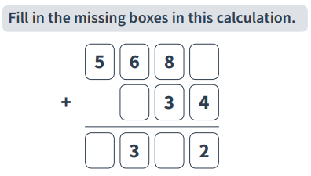
Fluent in Five
Grammar
Please complete this in your pink jotter.
“before” or “because”? Which is the best connective?
Mum was cross …. I broke her favourite vase.
Mum shouted at me … she sent me to my room.
I did all my work …. I had a choosing time.
My teacher said I could play …. I had finished all my work.
Can you write out each sentence again using a different connective?
Spellings
Put each word into a sentence
Reasoning
Group 1
Group 2
restaurant
rhyme
advice
advise
probably
promise
chef
chalet

Slide 18
PE & Forest School
Uniforms, PE kit and book bags must be clearly labelled.
Wellies must be worn for Forest School.
P.E - Monday and Thursday
Forest School - Thursday

Slide 19
SATs
End of Key Stage 2 SATs will take place between Monday 11th of May and Thursday 14th of May 2026.
The children will be well prepared ahead of time for these tests so please do not worry.
Our aim in Year 6, is to prepare the children for secondary school, it is not all focused on SATS.

Slide 20


e-safety
ICT including the internet, email and mobile technologies has become an important part of learning in our school. We want all children to be safe and responsible when using any ICT. During computing and PSHE lessons, pupils will learn about e-safety.
Please take care to ensure that appropriate systems are in place at home to protect and support your child. Each year, there are increasing numbers of social media issues and this is usually because the children involved are accessing sites that should not be used until the age of 13 – for example, Facebook,TikTok, Youtube, Snapchat and Instagram. WhatsApp has now changed to 16+. Please ensure your child does not have access to these apps and please regularly monitor their devices.
If you have any concerns or would like some advice please contact Mrs Waugh, Mrs Field or Mrs Gajjar.

Slide 21
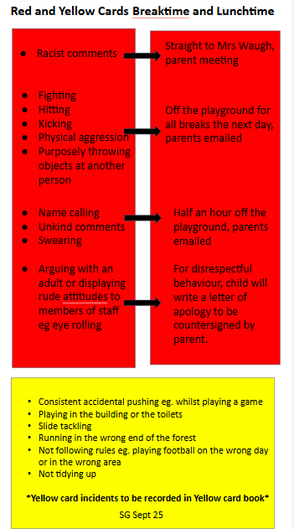

Slide 22
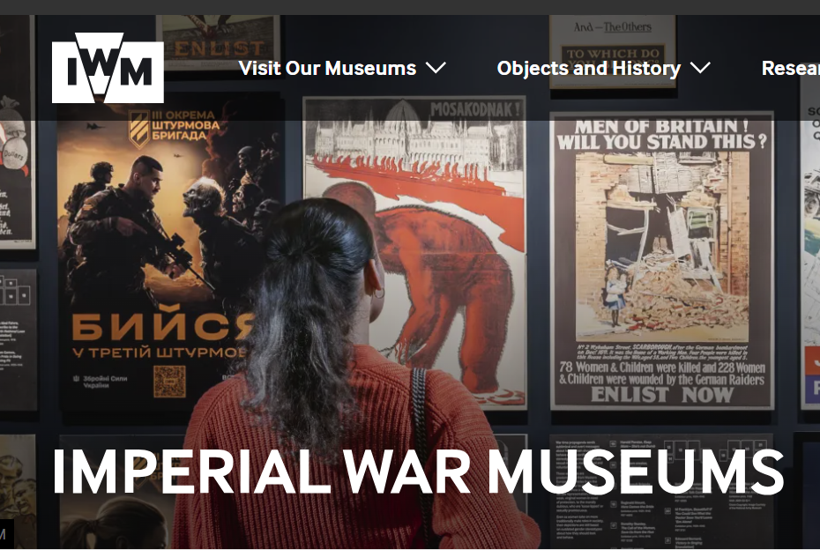
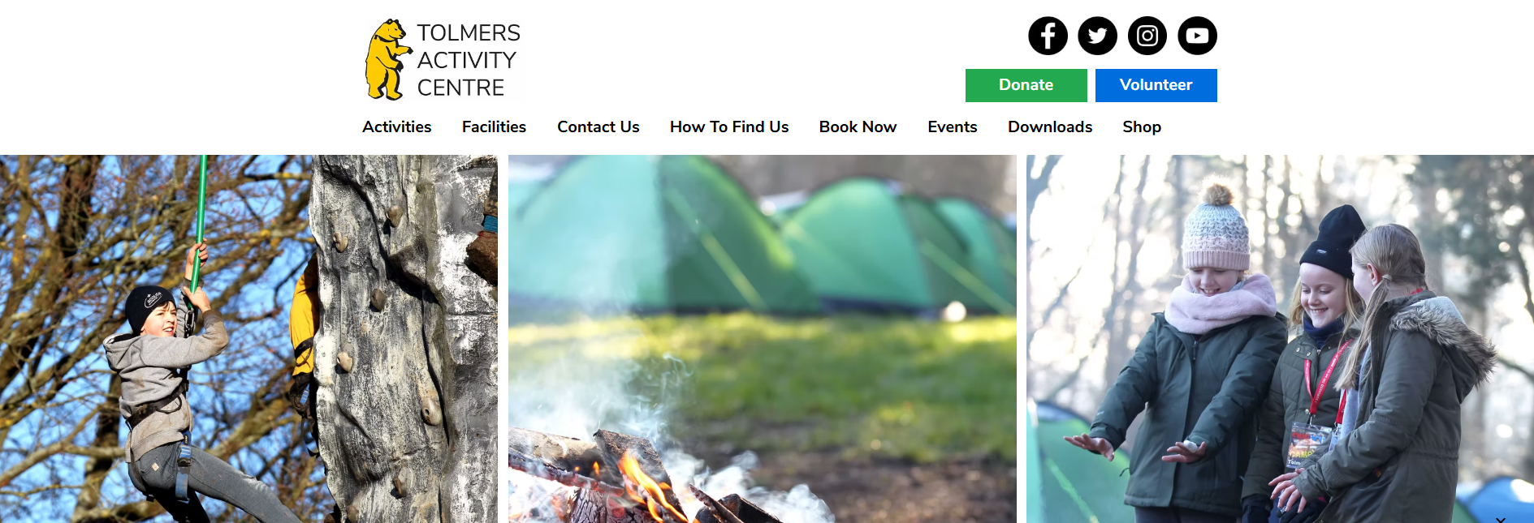
Year 6 trips
8th of July to the 10th of July

Slide 23
Secondary school applications

Slide 24
Any Questions?

