Slide 1


Slide 2

A Parent's Prayer
Lord, we pray for our children knowing that you care and watch over each of them completely.
Please encircle them with your great love and protection. Guide their pathways and walk beside them always. Minister by your Holy Spirit into their hearts and souls and bring your peace.
Bless them with goodness, come open their minds to the wonder and beauty of life.
Sow into their lives great heavenly treasure so they might carry light in their hearts and joy in their spirits.
Lord, may they understand more and more of your love for them.
May they appreciate themselves as you see them - unique and precious.
Father, please come and cover our parenting with your amazing love.
In Jesus name, Amen.

Slide 3

Welcome to Year 4
4G - Miss Goss
TAs - Mrs Augustus, Mrs Ee
4A - Mrs Asamoah
Mrs Mrabate

Slide 4

The Year 4 Curriculum
Our curriculum overview can be found on our class pages on the website.
This will keep you informed about what your child will be learning each week.
Included on the web page, you will find knowledge organisers, which will help you support your child in learning key terms and in understanding new vocabulary.

Slide 5
School Website
On our class pages you will be able to find:
A copy of this PowerPoint
Information about what the children will be learning this term
Knowledge organisers for subjects
Half termly homework grid

Slide 6
https://www.sphoward.herts.sch.uk/Year-4/

Slide 7
New e-mail communication
4G and 4A
year4*@sphoward.herts.sch.uk
Mrs Field & Miss Davies (special needs questions and information)
senco@sphoward.herts.sch.uk
Mrs Waugh, Headteacher head@sphoward.herts.sch.uk

Slide 8
How to help your child’s reading
Reading underpins all learning and it is an essential skill. It happens in all subjects.
We want our children to read for enjoyment but also be able to develop key skills such as reading for understanding.
Guided Reading will take place throughout the week as whole class sessions.
Teachers will hear your child read regularly, in different contexts.

Slide 9

Why does it make such a difference?
Increases their vocabulary
Develops their attention span
Improves their general knowledge
Makes them better writers.
How can you help?
Join the library, it’s free - go online (search ‘Hatfield Library’ & follow the link) or go into the library (closed on Sunday/Thurs)
If you are a library member you will also have access to free audio books through ‘BorrowBox’. Good for bedtime listening & it develops their vocabulary.
Read to your children and show them that you love books by reading yourself.

Slide 10
Reading At Home
Encourage your child to read for 15 minutes at least 4 times a week at home. It is THE most important thing that supports your child’s education. We do expect this to be noted in the reading record.
Find a suitable time that fits in with their routine.
Show an interest in what your child is reading by asking questions, and expect them to read with fluency.
Encourage reading for pleasure.
Please sign their reading record each week.

Slide 11
Spelling
On the website you will find the statutory spelling lists for Years 3/4.
These can be used at home to support your child with their spelling.
Your child will also have access to their SpellZone course pathway.

Slide 12
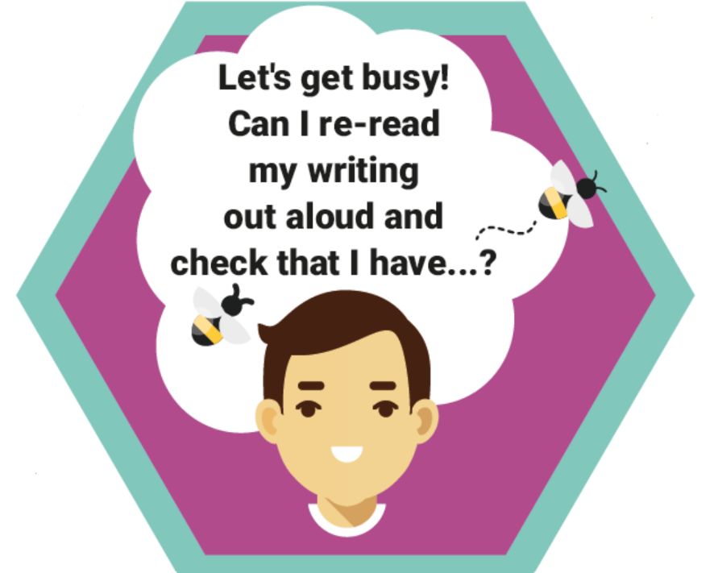
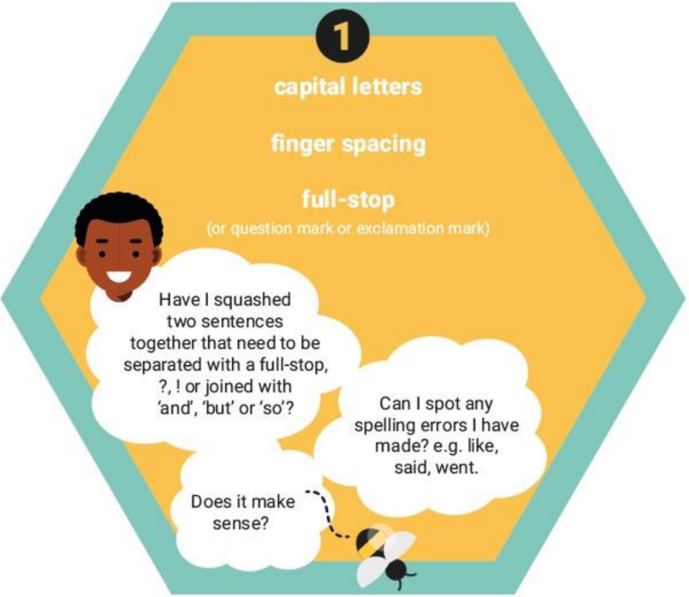
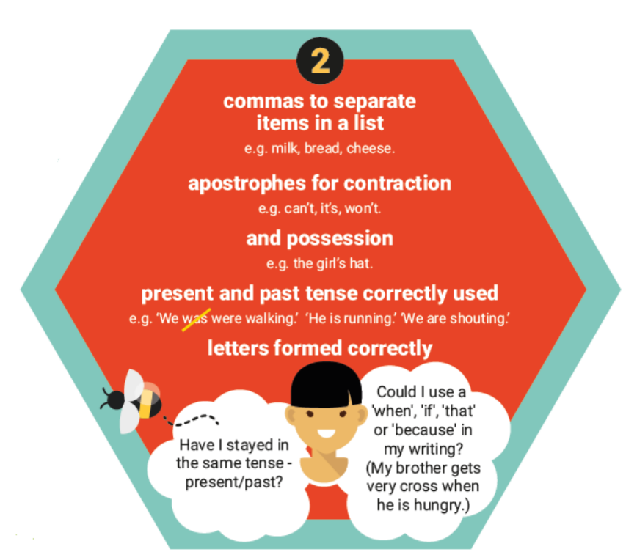
English

Slide 13
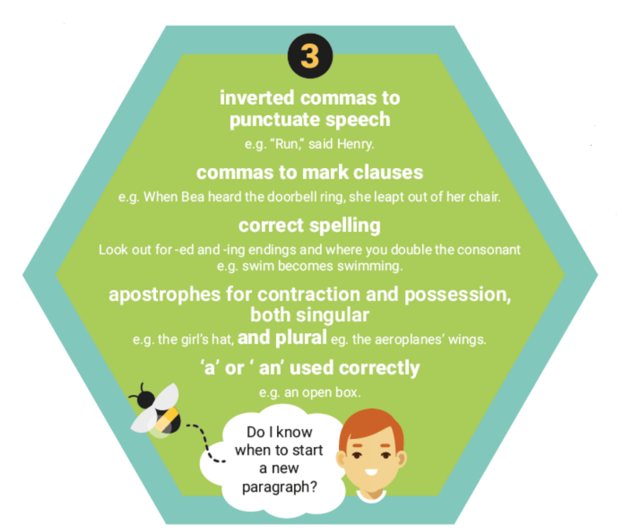

Slide 14
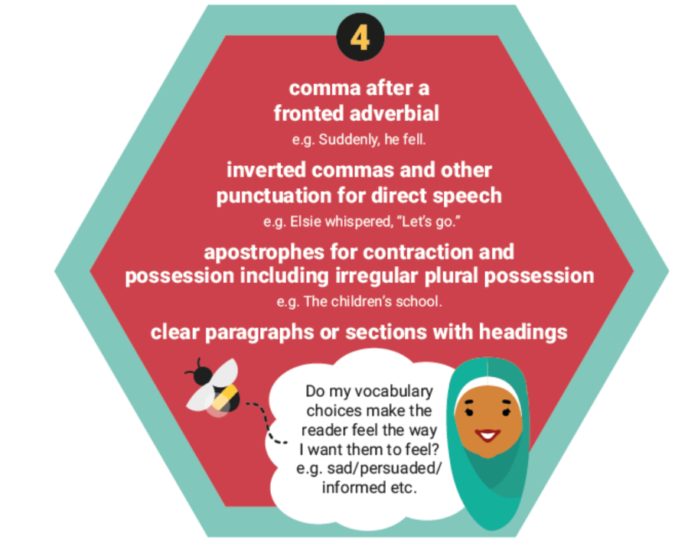

Slide 15
Maths
Year 4 Multiplication Tables Check (MTC). This is a government requirement for all pupils in Year 4. They must be fluent in all the times tables up to 12x12. The test will be sat in June 2025 and is online.
In order to fully prepare for the test, please start to support your child in learning their multiplication facts using Time Table Rock Stars (TTRS) or 1-minute White Rose App, Top Marks.
Your child will also need to become increasingly more confident with written methods for the four calculations - addition, subtraction, multiplication and division.
Your child will also have access to MyMaths and homework will be set on there and/or Google Classroom.

Slide 16
Useful links for Maths
*TTRS link
https://ttrockstars.com
*Top Marks
https://www.topmarks.co.uk/Search.aspx?Subject=16&AgeGroup=3

Slide 17
Homework
A half termly homework grids can be found on the class page. These tasks can be completed as and when. They can be submitted on Google Classroom or handed to the class teacher.
Spelling and Maths tasks may be set on a Friday, to be completed by the following Friday.
Spelling dictations will be completed during English, on the spelling pattern to ensure learning.

Slide 18
Attendance
Your child’s progress is greatly helped by good attendance. School starts at 8:40am and finishes at 3:15pm.
Early morning work is an important part of the school day (including interventions).
Registers are taken at 8:45am. Your child will be marked in as late after this.

Slide 19
PE & Forest School
Uniforms, PE kit and book bags must be clearly labelled.
Wellies must be worn for Forest School.
P.E. - Monday, Tuesday
Forest School - Friday
Swimming - Summer Term 2025

Slide 20
Home-School Agreement
https://docs.google.com/document/d/12B9604bDqpy5mDCQkBVLur9uxS1a48jm/edit

Slide 21
Social Media
Your children are not old enough to be using social media apps/sites, such as Instagram, WhatsApp, Tik Tok and Snapchat. The minimum age for users is 13 and when you register, your child’s date of birth is required.
As such, it is not the school’s responsibility to deal with any problems that arise from your child using these platforms. Please carefully monitor your child’s internet activity.
We strongly suggest that they do not have access to their mobile phones in their bedrooms at night time.

Slide 22


e-safety
ICT including the internet, email and mobile technologies has become an important part of learning in our school. We want all children to be safe and responsible when using any ICT. During computing and PSHE lessons pupils will learn about e-safety.
Please take care to ensure that appropriate systems are in place at home to protect and support your child. Each year, there are increasing numbers of social media issues and this is usually because the children involved are accessing sites that should not be used until the age of 13 – for example, Facebook,TikTok, Snapchat and Instagram. WhatsApp has now changed to 16+. Please ensure your child does not have access to these apps and please regularly monitor their devices.
If you have any concerns or would like some advice please contact Mrs Waugh, Mrs Field or Mrs Gajjar.

Slide 23
